Slide 1

Machine Learning with Multiscale Dataflow Computing for High Energy Physics
10.7.2019

Slide 2
Outline
Dataflow Concept and Maxeler
Dataflow for ML and Use Cases
Dataflow Programming Introduction
Hands-on Example
2

Slide 3
Dataflow Concept and Maxeler
10.7.2019

Slide 4
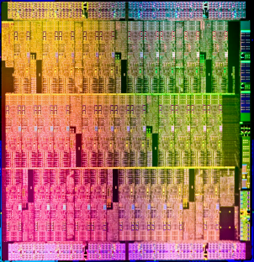
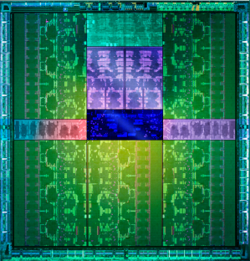
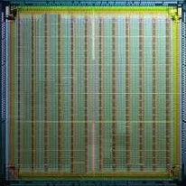
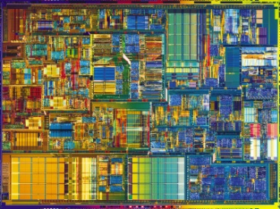
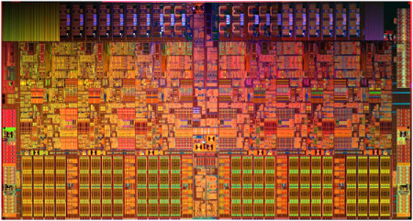
Programmable Spectrum
Control-flow processors
Dataflow processor
GK110
Single-Core CPU
Multi-Core
Several-Cores
Many-Cores
Dataflow
Increasing Parallelism (#cores)
Increasing Core Complexity ( Hardware Clock Frequency )
GPU (NVIDIA, AMD)
Tilera, XMOS etc...
Intel, AMD
Maxeler
Hybrid e.g. AMD Fusion, IBM Cell
4

Slide 5
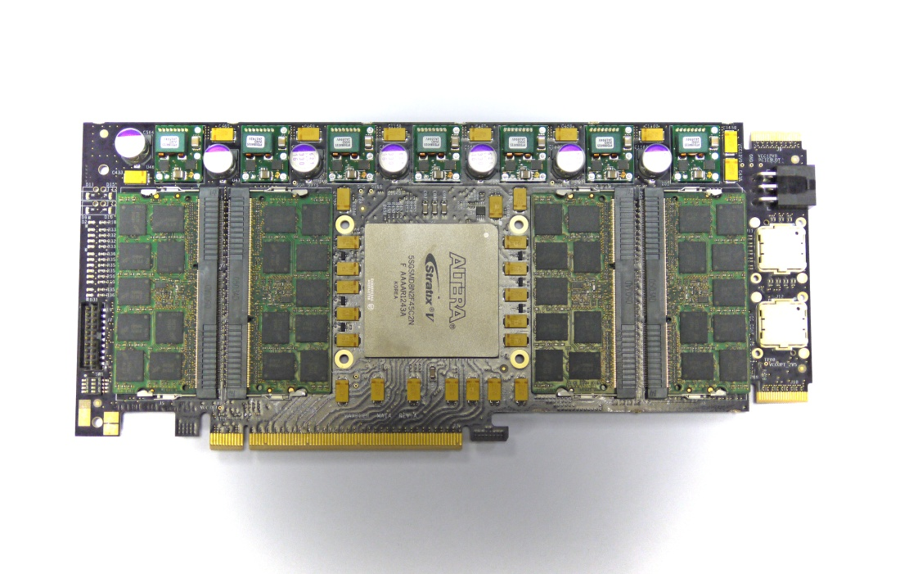
Maxeler Dataflow Engines (DFEs)
Largest Reconfigurable Chip
O(1k) multipliers
O(100k) logic cells
O(10MB) of on-chip SRAM
O(10GB) of on-card DRAM*
DFE-to-DFE interconnect
LMEM (Large Memory)
4-96GB
Dataflow Engine (DFE)
MaxRing
Interconnect
High bandwidth memory link
Reconfigurable compute fabric
Dataflow cores & FMEM (fast memory)
MaxRing links
Link to main data network
* approaching 128GB on a ¾, single slot PCIe card
5

Slide 6
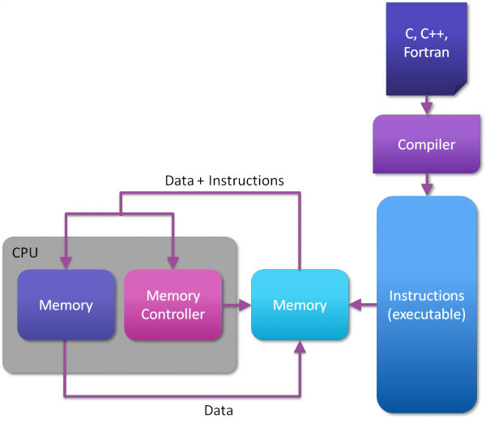
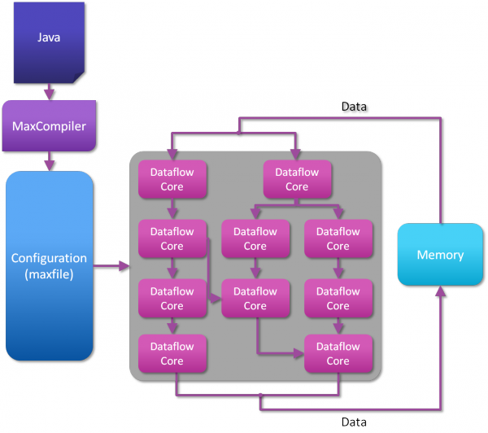
Maxeler Dataflow Engines (DFEs)
CPU
DFE
(Dataflow Engine)
6

Slide 7
Control Flow versus Data Flow
Control Flow:
It is all about how instructions “move”
Data may move along with instructions (secondary issue)
Order of computation is the key
Data Flow:
It is about how data moves through a set of “instructions” in 2D space
Data moves will trigger control
Data availability, transformations and operation latencies are the key
7

Slide 8
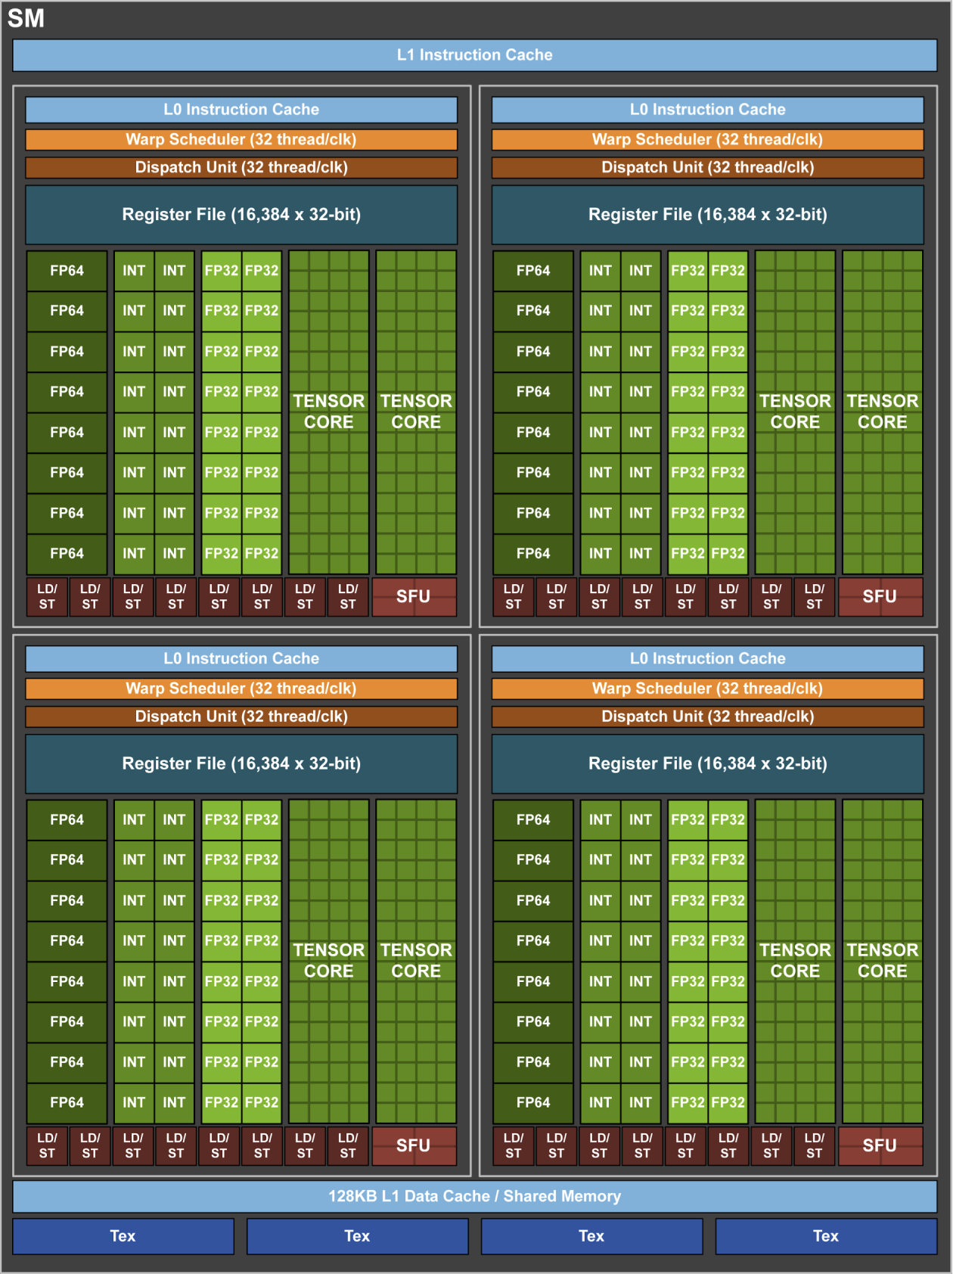
Area Utilisation of Modern Chips
AMD Bulldozer CPU
Nvidia Tesla V100 GPU
8

Slide 9
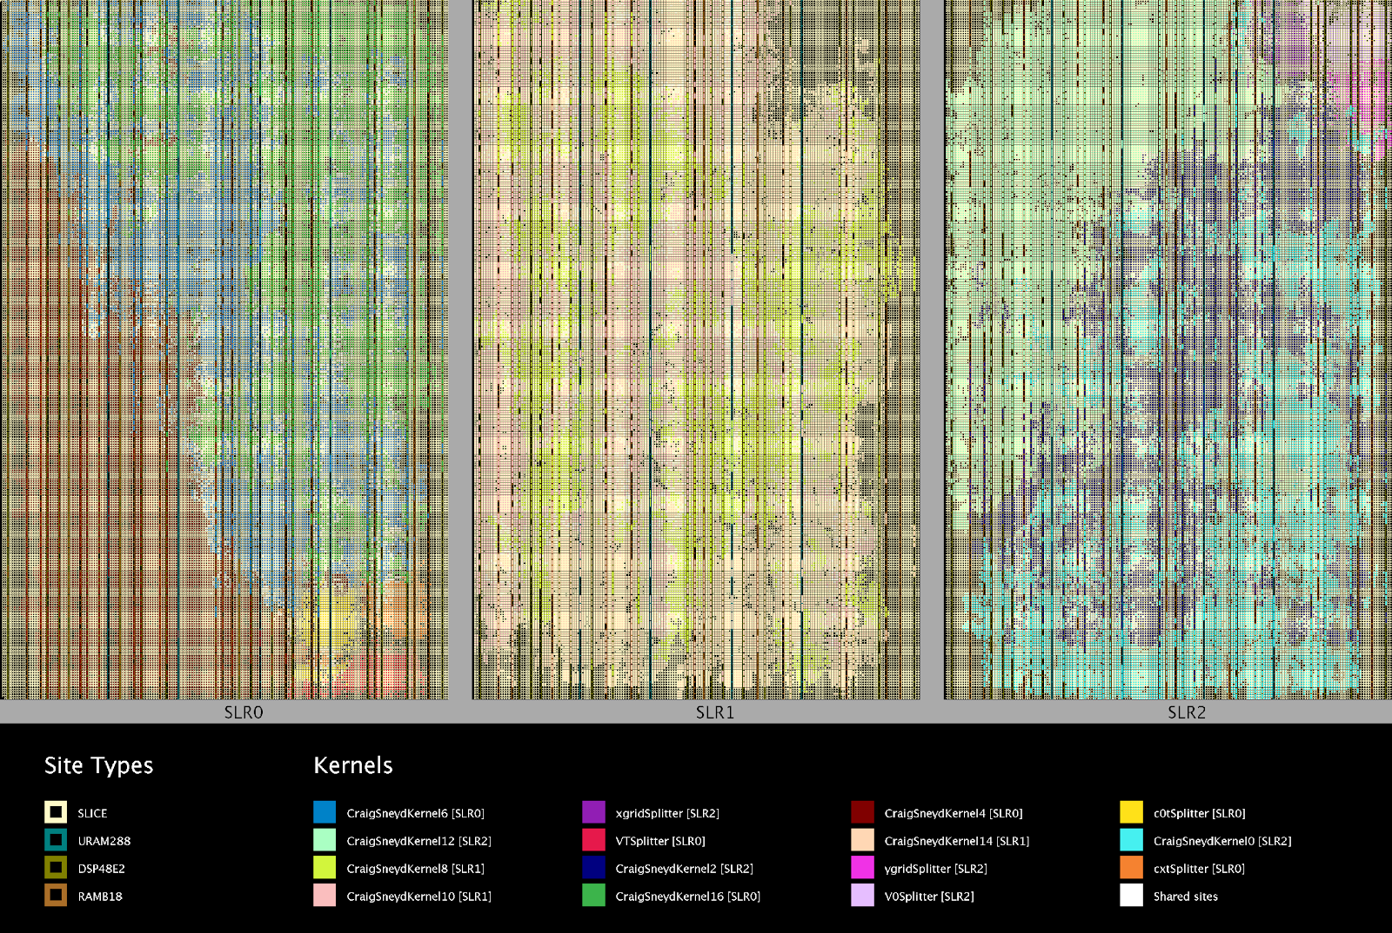
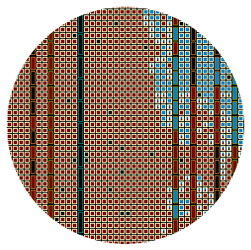
DFE Area Utilisation
9

Slide 10
Dataflow Computing
A custom chip for a specific application
No instructions ➝➔ no instruction decode logic
No branches ➔➝ no branch prediction
Explicit parallelism ➝➔ no out-of-order scheduling
Data streamed onto-chip ➝➔ no multi-level caches
Rest of the world
My Dataflow Engine
(Lots of) Memory
10

Slide 11
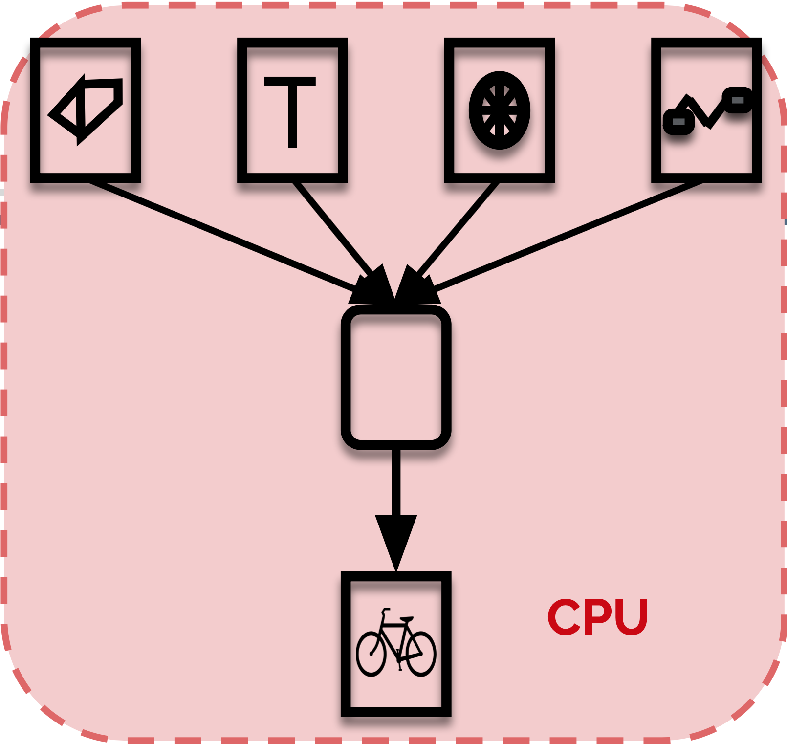
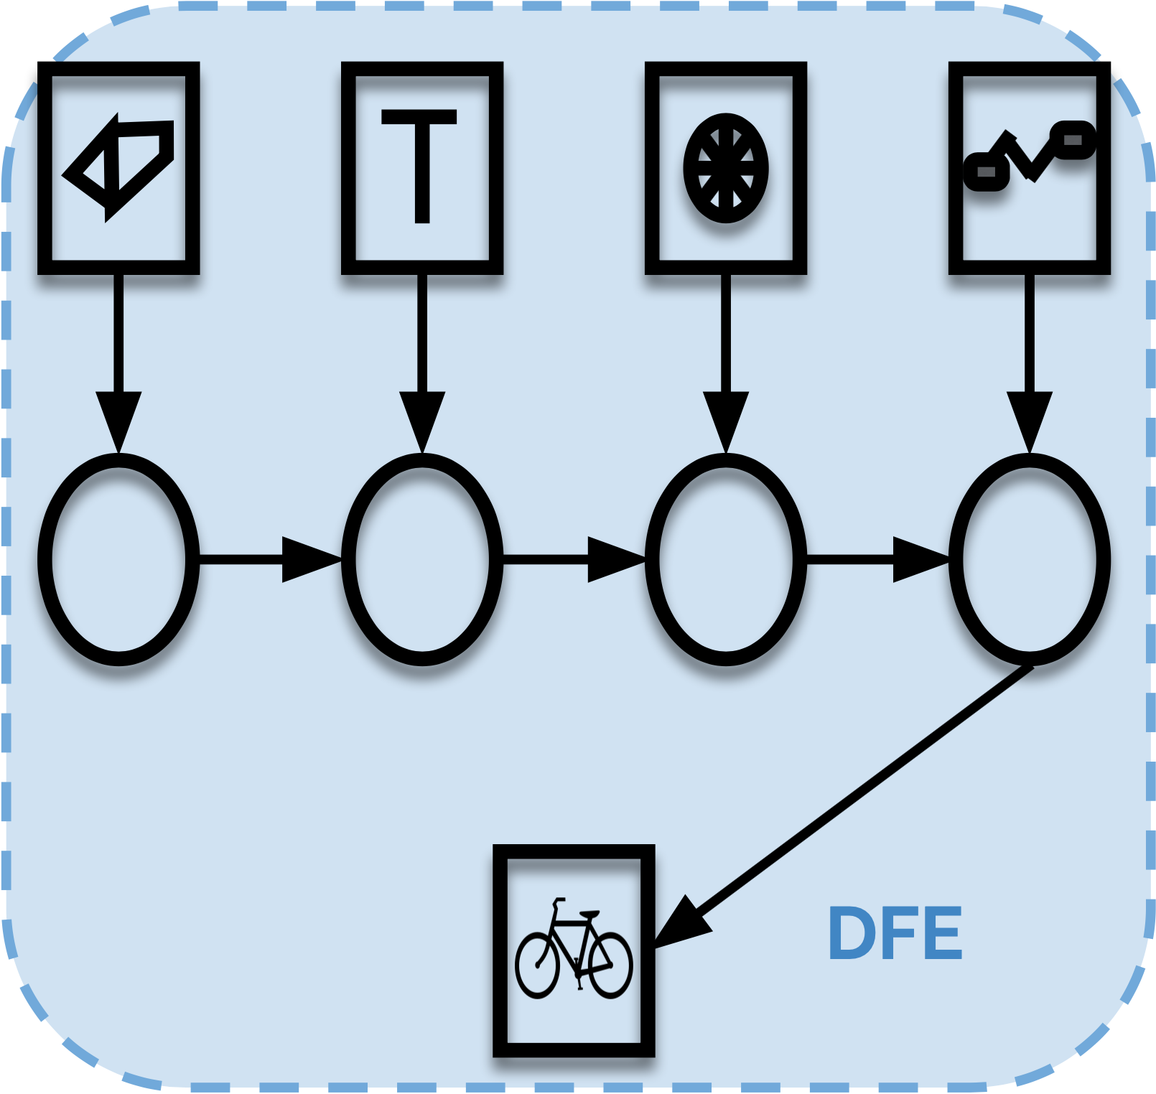
Dataflow Computing
Single worker builds a single bicycle from a group of parts
All operations must be done in sequence by the single worker
The worker expends/wastes a lot of time getting and selecting parts
Each component is added to the bicycle in a production line.
All operations happen in parallel with many workers
Only one types of parts needs to be delivered to each worker
11

Slide 12
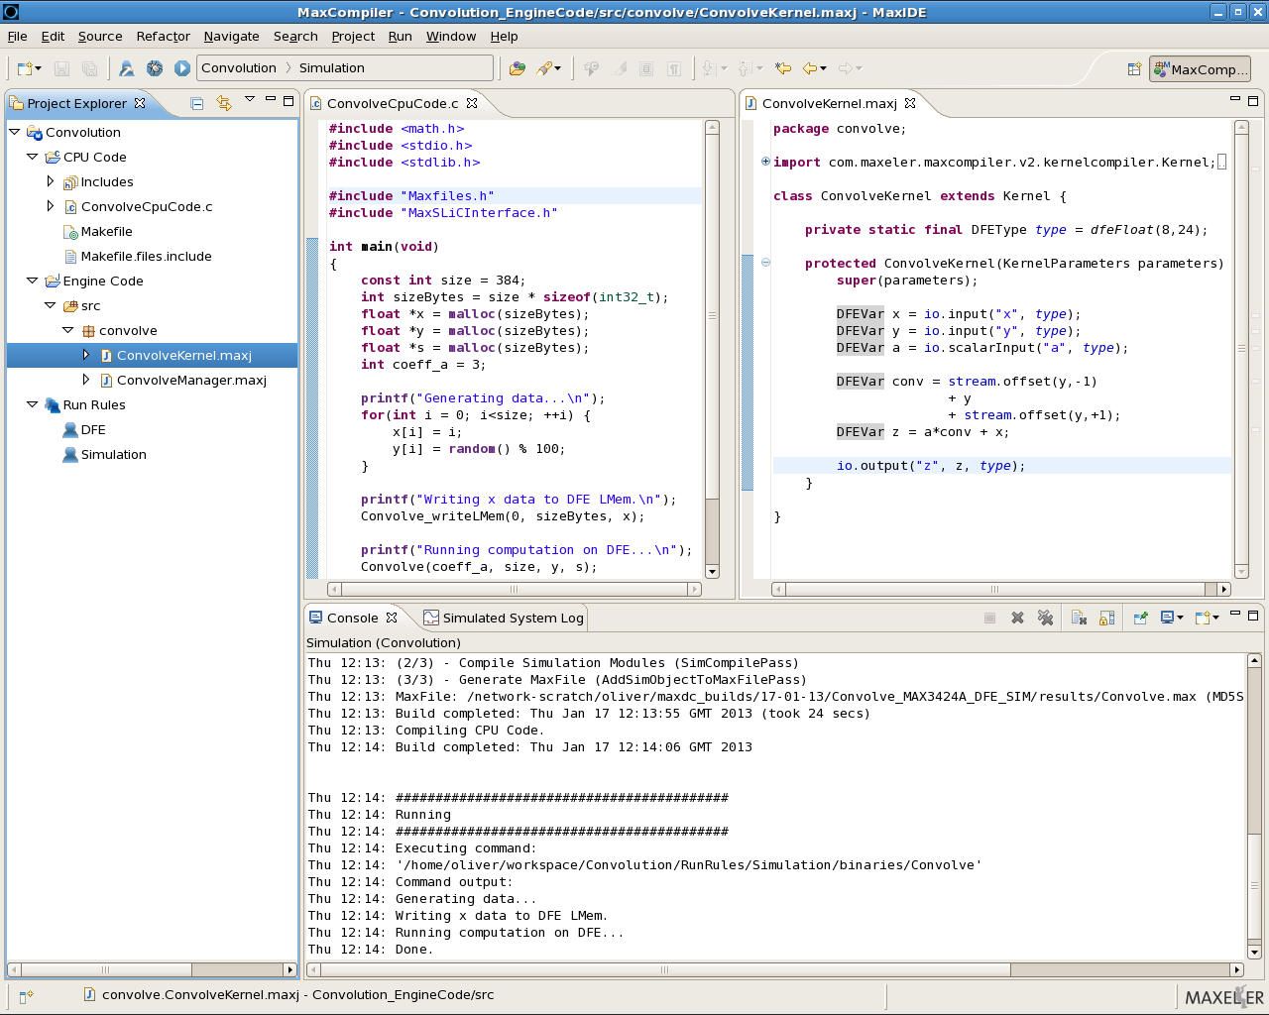
MaxCompiler: Dataflow Programming
12

Slide 13
FPGA vs Dataflow
Current DFEs are implemented using FPGA technology
Maxeler MAX4C, MAX4N, MAX5C
Xilinx Alveo
Amazon EC2 F1 instance
FPGA development for HPC often focused on kernels
E.g. accelerate matrix multiply, FFT, convolution
This often ignores I/O and memory bottlenecks
Dataflow looks at the complete application
Optimise Dataflow
Reduce Bandwidth requirements
Optimise throughput
13

Slide 14
Decelerate to Accelerate
CPU time 1,001s
Option 1 time 11s
Option 2 time 7s
CPU
DFE
DFE
Function1 – 1,000s
Function1 – 5s
Function1 – 5s
10G data transferred
Transfer 5s
CPU
Function2 – 2s
Function2 – 1s
Function2 – 1s
Some observations
At Kernel level:
Kernel 1 speedup 200x (!)
Kernel 2 “speedup” 0.5x (!)
At System level:
Option 1 (Kernel 1 only) speedup 91x
Option 2 (Kernels 1 and 2) speedup 143x
Final result only
CPU
But what about the required effort?
14

Slide 15
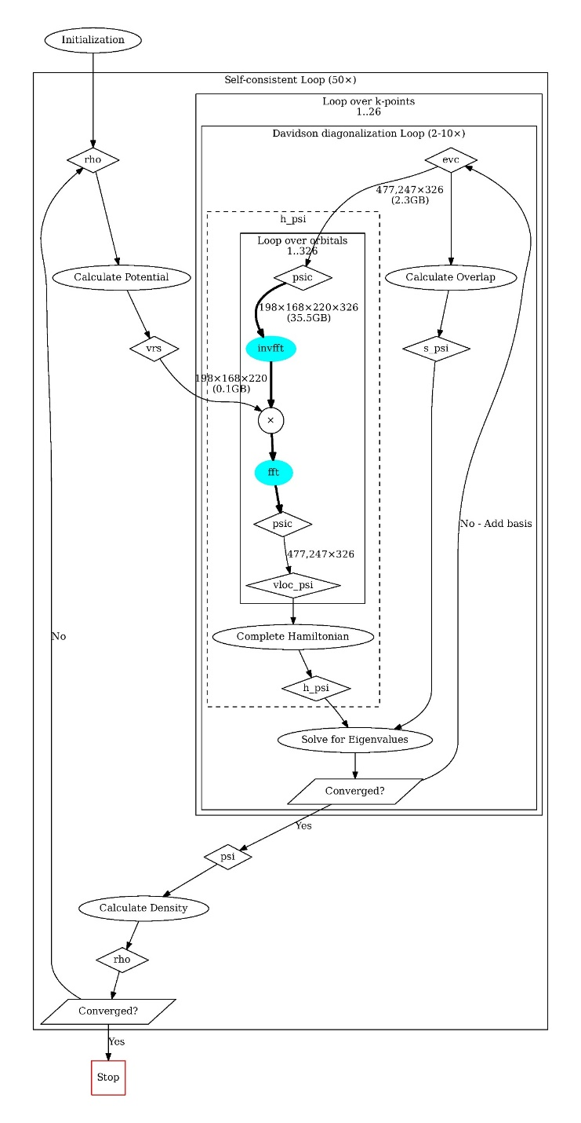
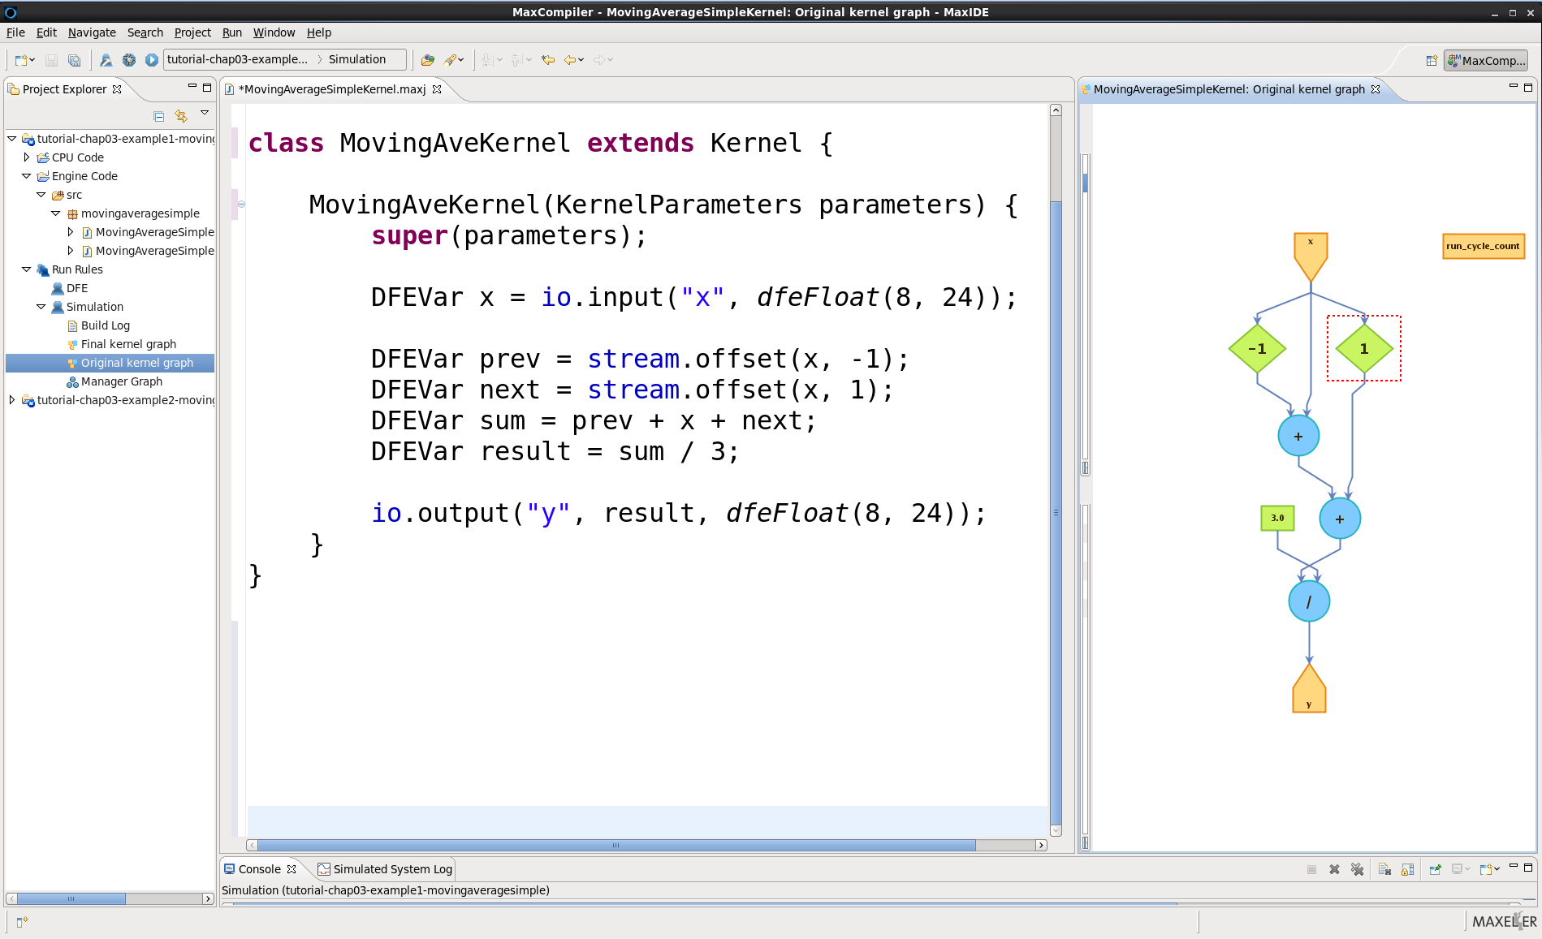
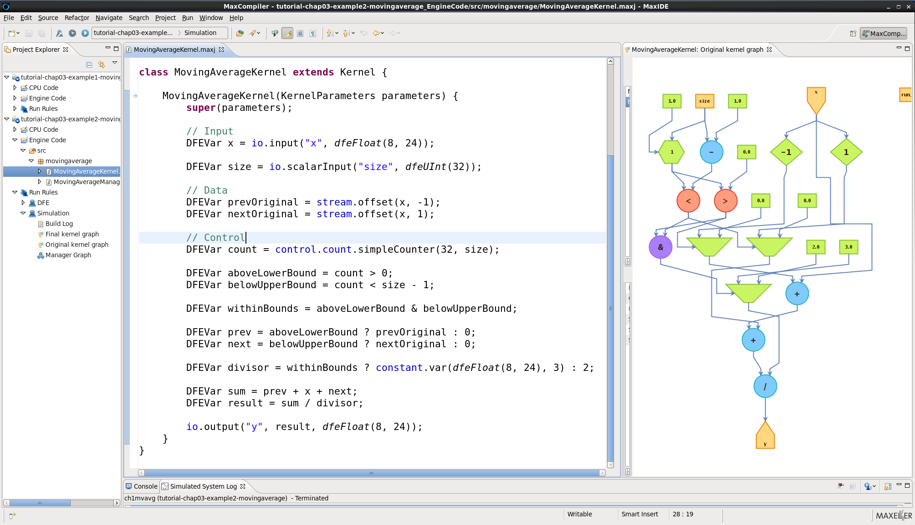
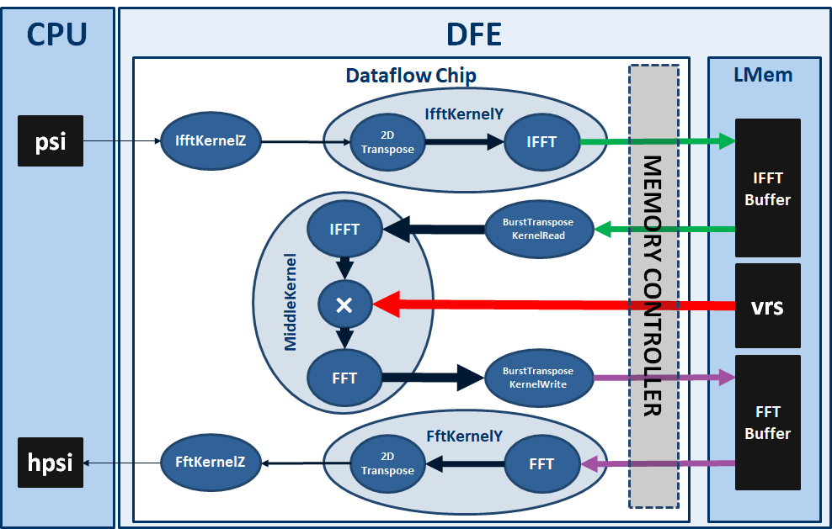
Non Traditional Design Process
ANALYSE
ARCHITECT
PROGRAM
GENERATE DATAFLOW
many hours …
OK?
SIMULATE AND DEBUG
Custom HW
Used to build balanced real systems, however, not easy to learn/educate
Notes:
Even better: the functions moved to the edge are fixed and do not change quite often --> HW

Slide 16
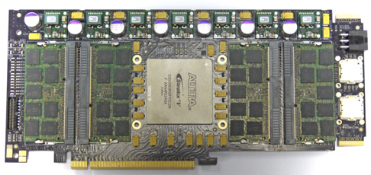
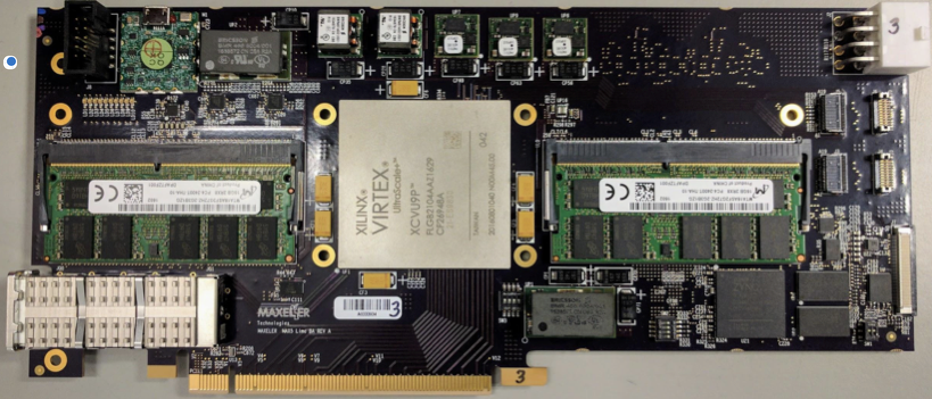
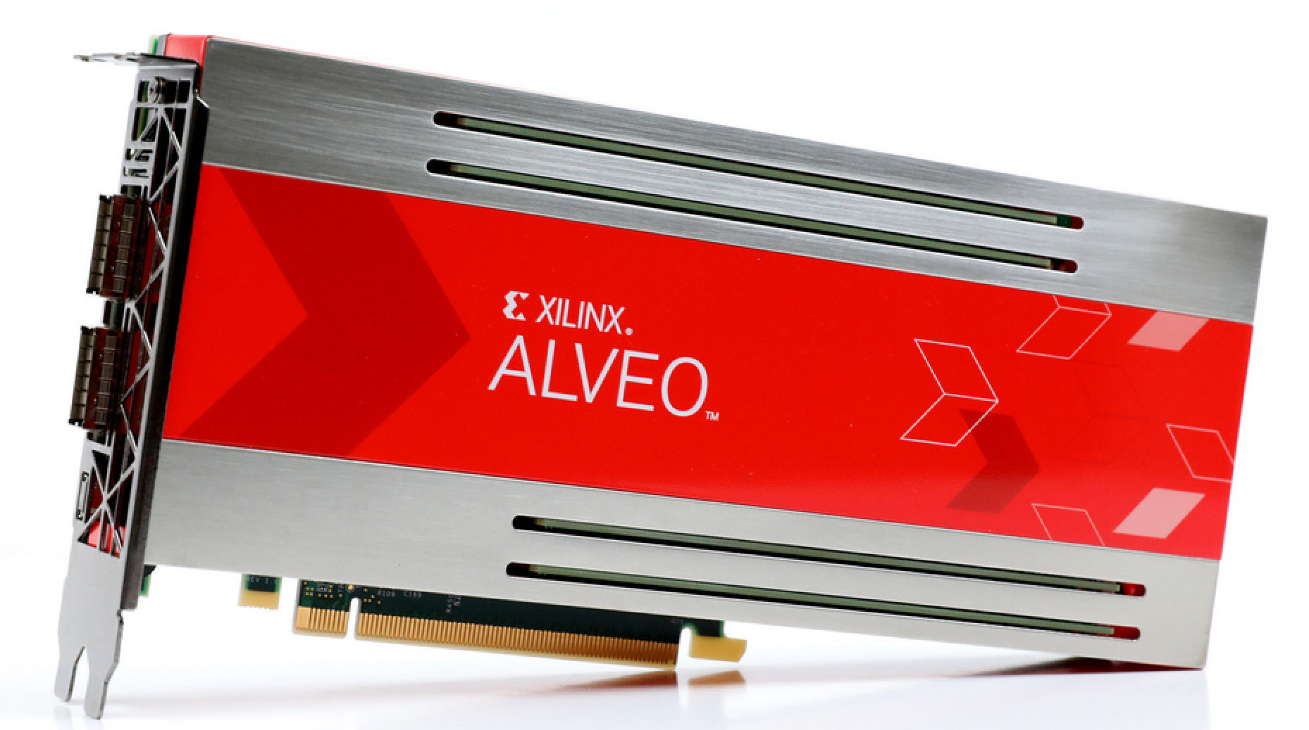
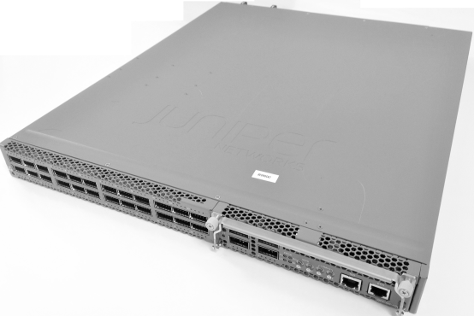

Multiple Platforms - Single Abstraction
Application and MaxJ
+
Performance Portable Migration
{
LMEM (Large Memory)
4-96GB
gen4
gen5
Dataflow Engine (DFE)
MaxRing
Interconnect
High bandwidth
memory link
Reconfigurable compute fabric
Dataflow cores & FMEM (Fast Memory)
MaxRing links
Link to main data network
(e.g., PCIe, Infiniband)
(MAX4 Intel based)
(MAX5 Xilinx based)

Slide 17
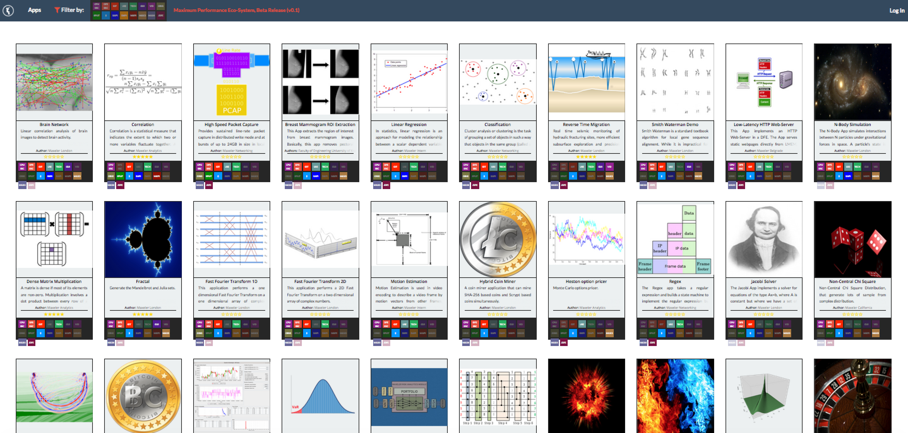

Maxeler Dataflow Software Ecosystem
http://appgallery.maxeler.com
17

Slide 18












































Over 150 Maxeler University Program Members
18

Slide 19
Dataflow for ML and Use Cases
10.7.2019

Slide 20
CNN Inference on DFEs
ICCD 2017: N. Voss et al: Convolutional Neural Networks on Dataflow Engines
High throughput implementation of VGG-16
~84.5 images/sec (224x224 pixels), 2.45 TOP/s
We made further improvements:
Support for generic CNNs
All input image sizes supported (up to 10K images)
Higher Speed
Available on MAX5C, Alveo and Amazon F1
20

Slide 21
CNN Traning on DFEs
21

Slide 22
Dataflow vs GPU for ML
Advantages:
Predictable, guaranteed low latency
Low power usage
Fully custom types
E.g. binary or ternary networks possible
But also 20 bit if required
Can be fed directly from networking connections
No bottleneck of getting data from network via CPU and PCIe to the GPU
Lower cooling and space requirements
Disadvantages:
Currently not fully integrated into common ML libraries
More development effort required
22

Slide 23
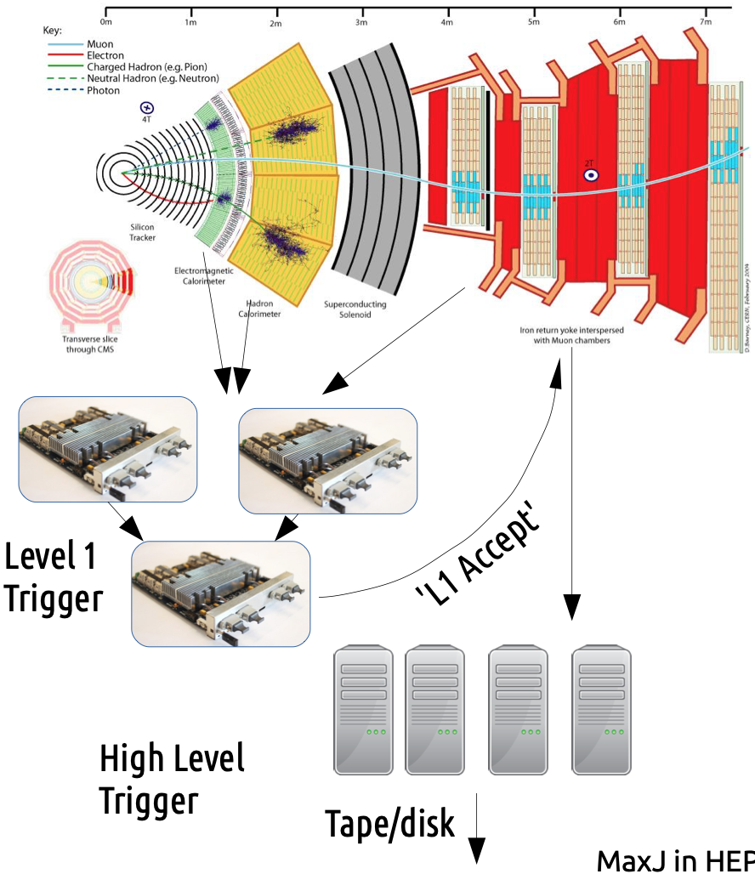

Triggering at CMS
Study by PhD student at imperial
Reimplement triggering algorithm using MaxJ
 | VHDL | MaxJ
LUTs | 95,235 | 102,508
Slice Regs. | 153,198 | 130,072
DSPs | 288 | 288
BRAM tiles | 0 | 0
Lines of Code | 3,000 | 1,000
Developer Experience | 10+ years | < 1 year
23

Slide 24
Kalman Filter
Study by PhD student at imperial
Implement Kalman Filter using MaxJ
Implemented in Fixed Point
36 instances per Virtex 7 FPGA with 230ns latency per iteration
Second group:
Worried that Kalman Filter to complicated for FPGA
-> Simplified math
Implement linear regression in VHDL
Took longer than MaxJ effort
Result: Complicated maths in MaxJ > easy maths in VHDL
24

Slide 25
EU PRACE PCP
Delivered to Jülich in 2017
EU funded
Ported for applications
Quantum ESPRESSO (Quantum Chemistry)
Berlin QCD (Quantum Chromodynamics)
NEMO (Ocean Modelling)
SPECFEM3D (Seismic Modelling)
Target: 20-50x better performance density
25

Slide 26
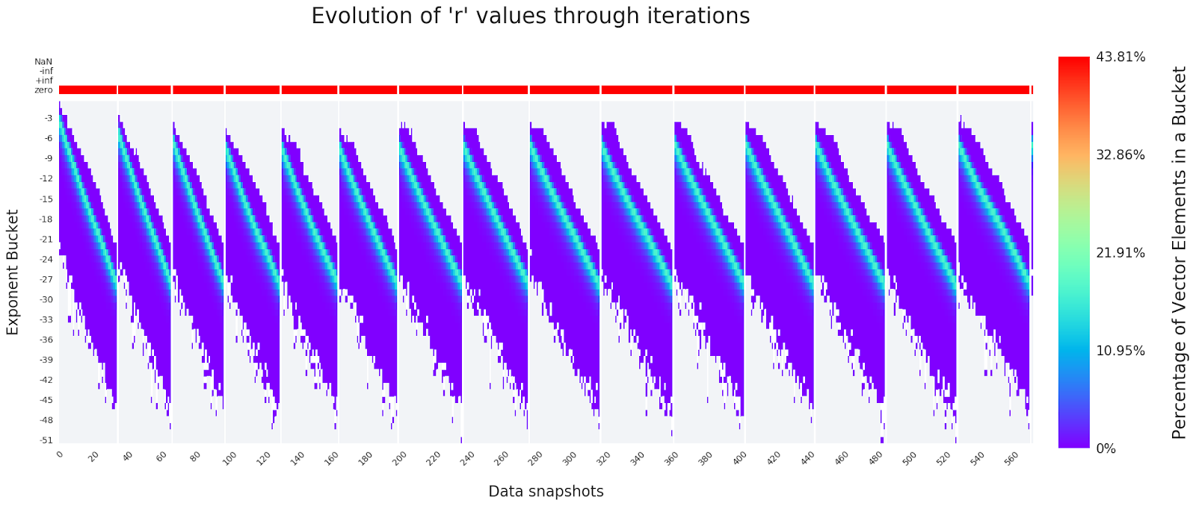
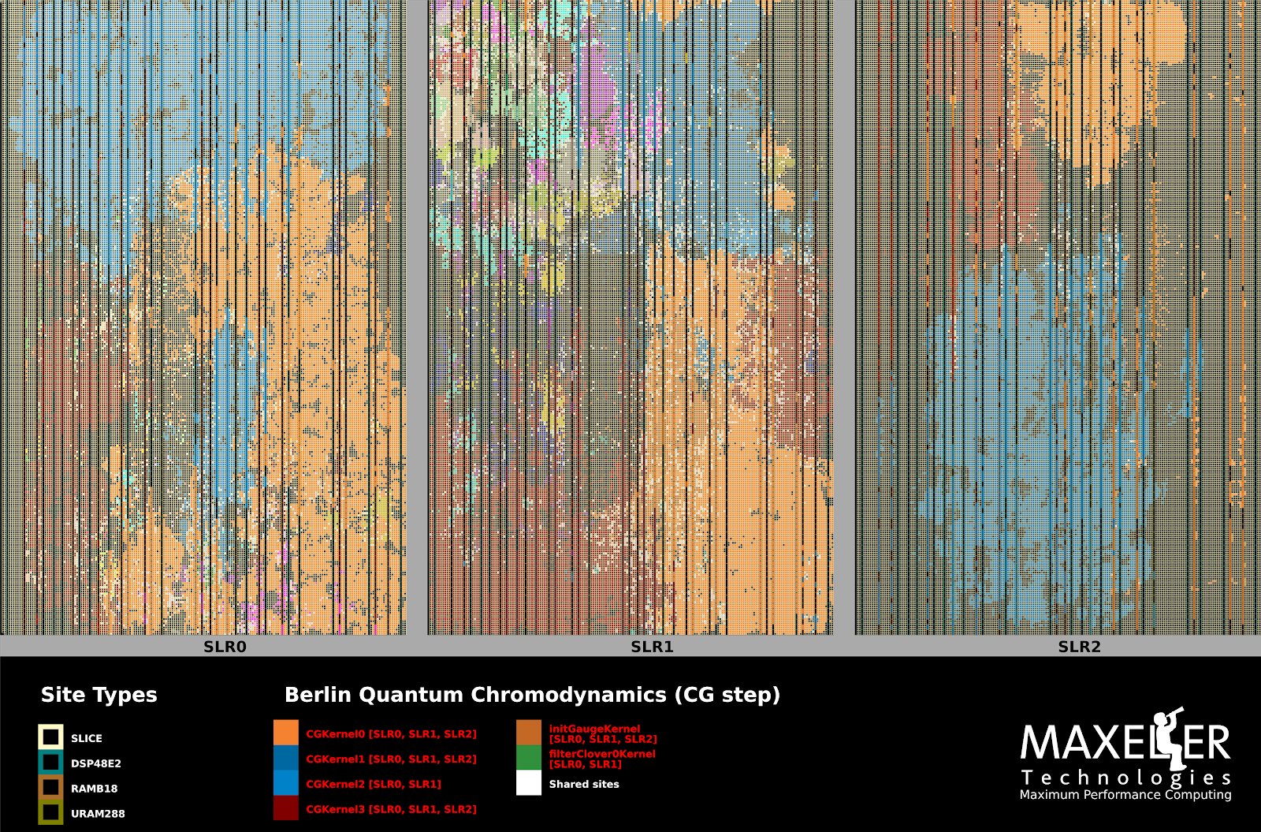
BQCD
Run CG of any size on a single DFE, with highly accurate results
Custom numerics in 24bit fixed point
Setup for BQCD:
Target system: 11 MPC-X nodes (88 DFEs) and 24 AMD EPYC nodes
Speedup on compute per volume basis, for 1 PFlop/s performance:
38x CG only; 18x whole application
26

Slide 27
Radiotherapy
Radiotherapy: Cancer treatment using radiation
Target: Real time (< 1s) Monte Carlo simulation of dose accumulation
Enables adaptive treatment
Reduces overall dose delivered to patient
Managed to achieve a speedup of over 8x compared to GPUs
Real time simulation possible using three FPGA cards
Paper will be presented next week at ASAP conference
27

Slide 28
Future Project: XFEL
We are currently planning a project with European XFEL
Target:
Enable real-time visualisation of sensor output
Use 4 DFEs to perform data calibration
First only for the AGIPD detector
28

Slide 29
Dataflow Programming Introduction
10.7.2019

Slide 30

Dataflow Graph
a = b * (c + b * d)
c
d
b
x
+
x
a
30

Slide 31
MaxJ Intro: Programming
Example: x² + 30
x
x
DFEVar x = io.input("x", dfeInt(11));
DFEVar result = x * x + 30;
io.output("y", result, dfeInt(11));
30
+
y
31

Slide 32
MaxJ Intro: What is a DFEVar?
A connection between operators in the dataflow graph
An edge in the dataflow graph
A stream of data elements of a certain type and size
Physically it is a set of wires in the hardware
It looks like a variable in MaxJ code
IT IS NOT A VARIABLE! (in the traditional CS sense)
32

Slide 33
MaxJ Intro: Java meta-programming
You can use the full power of Java to write a program that generates the dataflow graph
Java variables can be used as constants in hardware
int y; DFEVar x; x = x + y;
Hardware variables can not be read in Java!
Cannot do: int y; DFEVar x; y = x;
Java conditionals and loops choose how to generate hardware → not make run-time decisions
Once you execute your Java program the generated graph is what exist in your application (not the Java)
We do not execute Java on the DFE!
33

Slide 34
MaxJ Intro: Dataflow Graph Generation
x
DFEVar x = io.input(“x”, type);
DFEVar y;
y = x + 1;
io.output(“y”, y, type);
1
+
y
34

Slide 35
MaxJ Intro: Dataflow Graph Generation
x
DFEVar x = io.input(“x”, type);
DFEVar y;
y = x * x + x;
io.output(“y”, y, type);
x
+
y
35

Slide 36
MaxJ Intro: Dataflow Graph Generation
What’s the value of h if we stream in 1?
DFEVar h = io.input(“h”, type);
int s = 2;
s = s + 5
h = h + 10
h = h + s;
h
+
10
+
7
18
What’s the value of s if we stream in 1?
DFEVar h = io.input(“h”, type);
int s = 2;
s = s + 5
h = h + 10
s = h + s;
Compile error.
You can’t assign a hardware value to a Java int
36

Slide 37
MaxJ Intro: Dataflow Graph Generation
x
What dataflow graph is generated?
DFEVar x = io.input(“x”, type);
int s = 10;
DFEVar y;
if (s < 100) { y = x + 1; }
else { y = x – 1; }
io.output(“y”, y, type);
1
+
y
What dataflow graph is generated?
DFEVar x = io.input(“x”, type);
DFEVar y;
if (x < 10) { y = x + 1; }
else { y = x – 1; }
io.output(“y”, y, type);
Compile error.
You can’t use the value of ‘x’ in a Java conditional
37

Slide 38
MaxJ Intro: Dataflow Graph Generation
x
DFEVar x = io.input(“x”, type);
DFEVar y = x;
for (int i = 1; i <= 3; i++) {
y = y + i;
}
io.output(“y”, y, type);
Can make the loop any size – until you run out of space on the chip!
Larger loops can be partially unrolled in space and reused multiple times in time
1
+
2
+
3
+
y
38

Slide 39
MaxJ Intro: Java meta-programming
You describe a dataflow graph generation using Java syntax
Objects in the MaxCompiler API are used to generate hardware or configure the hardware/the build process
Java API is crafted to ease the generation of massive dataflow graphs
Object Orientation is possible and encouraged (e.g. using KernelLibs)
You can write generic code which optimises itself on the fly
You can write optimisation libraries, e.g., MaxPower
Many normal Java libraries can be used, e.g., JUnit
39

Slide 40
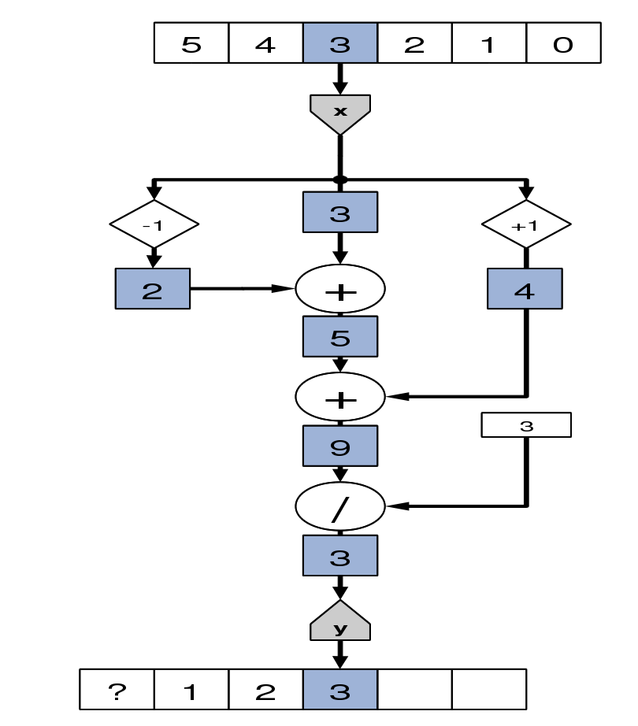
MaxJ Intro: Example: Moving Average
class MovingAvgKernel extends Kernel {
MovingAvgKernel() {
DFEVar x = io.input(“x”, dfeFix(24,12));
DFEVar prev = stream.offset(x, -1);
DFEVar next = stream.offset(x, 1);
DFEVar sum = prev + x + next;
DFEVar result = sum / 3;
io.output(“y”, result, dfeFix(24,12));
}
}
40

Slide 41
MaxJ Intro: Scheduling
The dataflow graph in a kernel is statically scheduled and will be executed simultaneously in a parallel fashion
Operations have inherent latencies
If different data paths meet, they need to be balanced and delays are inserted
The scheduler tries to minimise the costs of implementing those delays
You can add manual scheduling constraints with stream.offset()
41

Slide 42
MaxJ Intro: Scheduling
x
DFEVar x = io.input(“x”, type);
DFEVar y;
y = (x + x) * x;
io.output(“y”, y, type);
+
1
x
y
42

Slide 43
MaxJ Intro: Scheduling
x
DFEVar x = io.input(“x”, type);
DFEVar y;
y = (x + x) * stream.offset(x, 1);
io.output(“y”, y, type);
+
x
y
43

Slide 44
MaxJ Intro: Control in Space
x
class SimpleKernel extends Kernel {
SimpleKernel() {
DFEVar x = io.input(“x”, dfeFix(24,12));
DFEVar result = (x>10) ? x+1 : x-1;
io.output(“y”, result, dfeFix(24,12));
}
}
1
10
1
>
+
-
mux
y
44

Slide 45
MaxJ Intro: Spatial Arithmetic
Operations instantiated as separate arithmetic units
Units along data paths use custom arithmetic and numeric representations (as long data stays correct)
These custom number formats may reduce individual unit sizes (and increase the number of parallel units that can fit into a given DFE)
Data rates of memory and I/O communication are also typically increased due to reduced data sizes
45

Slide 46
MaxJ Intro: Optimisations at all levels
Multiple scales of computing | Important features for optimization
complete system level | balance compute, storage and IO
parallel node level | maximize utilization of compute and interconnect
microarchitecture level | minimize data movement
arithmetic level | tradeoff range, precision and accuracy = discretize in time, space and value
bit level | encode and add redundancy
46

Slide 47
MaxJ Intro: Development Process
Start
Original Application
Identify code for acceleration and analyze bottlenecks
Transform app, architect and model performance
Write MaxCompiler code
Integrate with CPU code
Simulate
NO
NO
YES
Meets performance goals?
YES
Functions correctly?
Build DFE
Accelerated Application
47

Slide 48
MaxJ Intro: Build Process
Host Application *.c, *.f90 ...
Rewrite only DFE- migrating code
MyKernel.maxj
MyManager.maxj
User Input
MaxIDE
Compiler
MaxelerOS
Library
MaxCompiler
SLiC
Library
.max File
Sim or H/W
(.max)
Linker
Output
Output
Executable
48

Slide 49
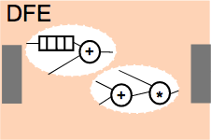
MaxJ Intro: Application Components
CPU
Host application (C, Python, Matlab..)
SLiC
MaxelerOS
Kernels (MaxJ)
(instantiate the arithmetic structure)
PCI Express
Memory
Memory
Manager (MaxJ)
(arrange the data orchestration)
49

Slide 50
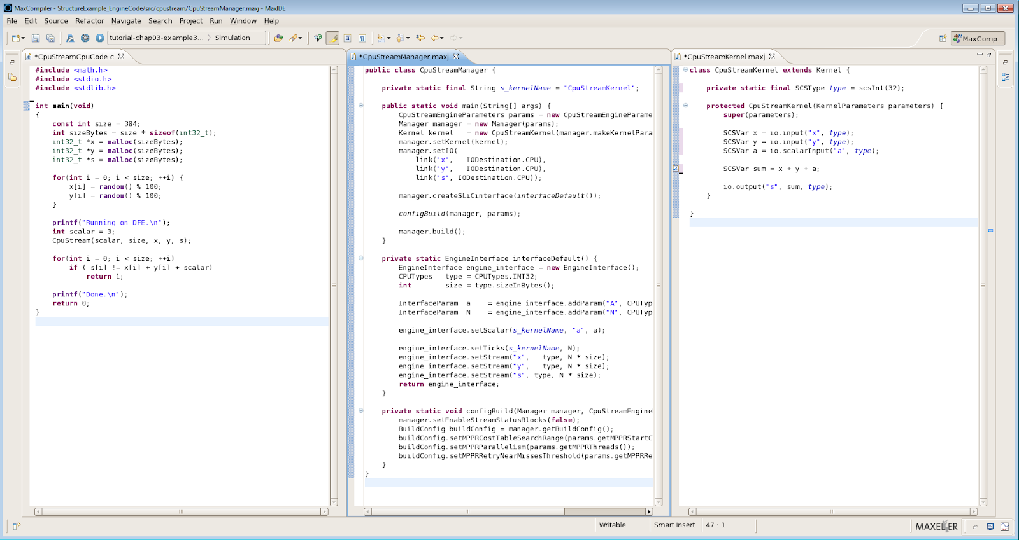
MaxJ Intro: Parts to create a DFE
CPU Code
Manager Code
Kernel Code
50

Slide 51
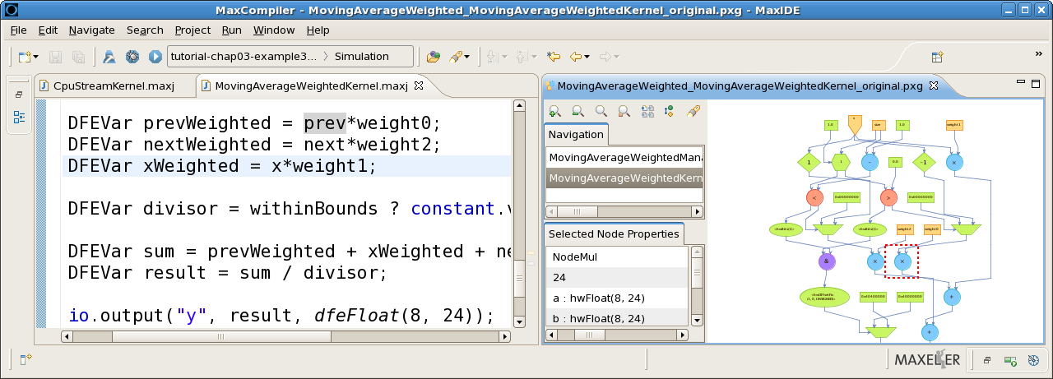
MaxJ Intro: Programming Components
MaxCompiler – Java-driven dataflow compiler
SLiC Interface – CPU integration
MaxelerOS – optimized DFE <-> CPU link
Seamless simulation environment
51

Slide 52
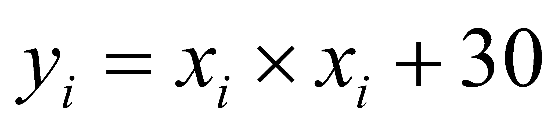
MaxJ Intro: Simple Application Example
CPU
CPU
Code
Host Code (.c)
int*x, *y;
for (int i =0; i < DATA_SIZE; i++)
y[i]= x[i] * x[i] + 30;
Main
Memory
52

Slide 53
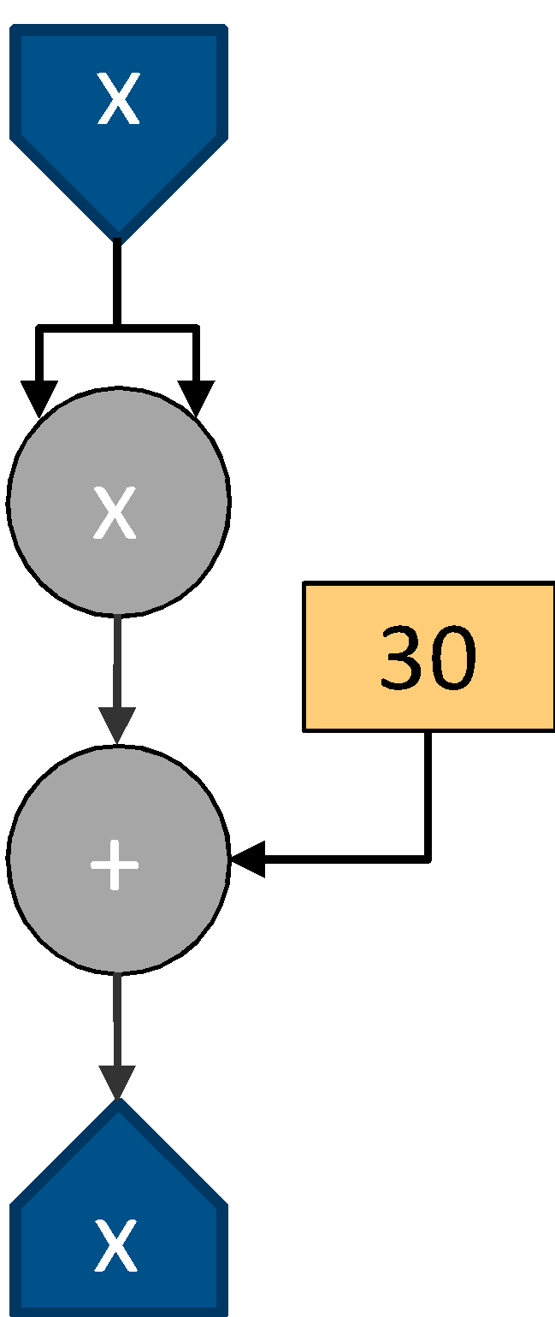
MaxJ Intro: Simple Application Example
CPU
Memory
x
CPU
Code
DFE
x
SLiC
MaxelerOS
Manager
30
PCI
Express
+
Main
Memory
x
y
y
MyManager (.maxJ)
Manager m = new Manager();
Kernel k =
new MyKernel();
m.setKernel(k);
m.setIO(
link(“x", CPU),
link(“y", CPU));
m.build();
Host Code (.c)
MyKernel (.maxJ)
int*x, *y;
MyKernel( DATA_SIZE,
x, y, DATA_SIZE*4);
DFEVar x = io.input("x", dfeInt(32));
DFEVar result = x * x + 30;
io.output("y", result, dfeInt(32));
53

Slide 54
MaxJ Intro: Simple Application Example
CPU
Memory
x
CPU
Code
DFE
x
SLiC
MaxelerOS
Manager
30
PCI
Express
+
Main
Memory
x
y
MyManager (.maxJ)
Manager m = new Manager();
Kernel k =
new MyKernel();
m.setKernel(k);
m.setIO(
link(“x", CPU),
link(“y", DRAM_LINEAR1D));
m.build();
Host Code (.c)
MyKernel (.maxJ)
int*x, *y;
MyKernel( DATA_SIZE,
x, y, DATA_SIZE*4);
DFEVar x = io.input("x", dfeInt(32));
DFEVar result = x * x + 30;
io.output("y", result, dfeInt(32));
54

Slide 55
Dataflow Programming Introduction:
Kernels
10.7.2019

Slide 56
Kernels: The Full Kernel
Example: x² + 30
public class MyKernel extends Kernel {
public MyKernel (KernelParameters parameters) {
super(parameters);
DFEVar x = io.input("x", dfeInt(11));
DFEVar result = x * x + 30;
io.output("y", result, dfeInt(11));
}
}
x
x
30
+
y
56

Slide 57
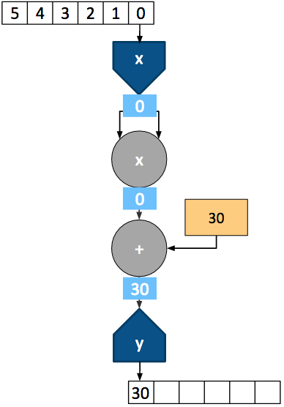
Kernels: Streaming Data
57

Slide 58
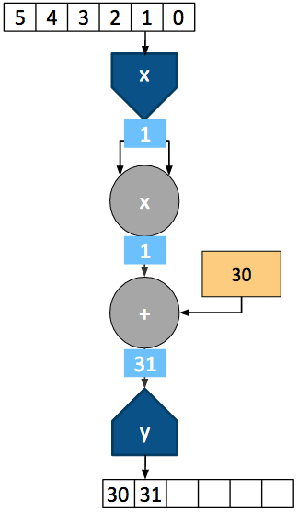
Kernels: Streaming Data
58

Slide 59
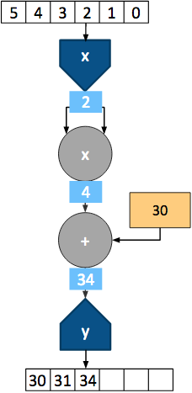
Kernels: Streaming Data
59

Slide 60
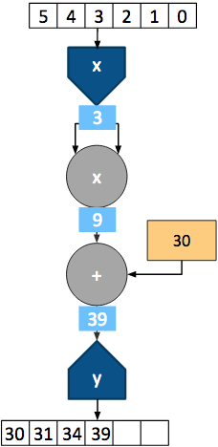
Kernels: Streaming Data
60

Slide 61
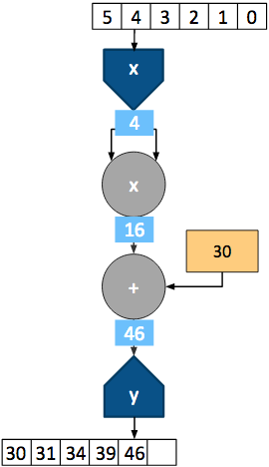
Kernels: Streaming Data
61

Slide 62
Kernel: What about Moving Average
class MovingAvgKernel extends Kernel {
MovingAvgKernel() {
DFEVar x = io.input(“x”, dfeFix(24,12));
DFEVar prev = stream.offset(x, -1);
DFEVar next = stream.offset(x, 1);
DFEVar sum = prev + x + next;
DFEVar result = sum / 3;
io.output(“y”, result, dfeFix(24,12));
}
}
62

Slide 63
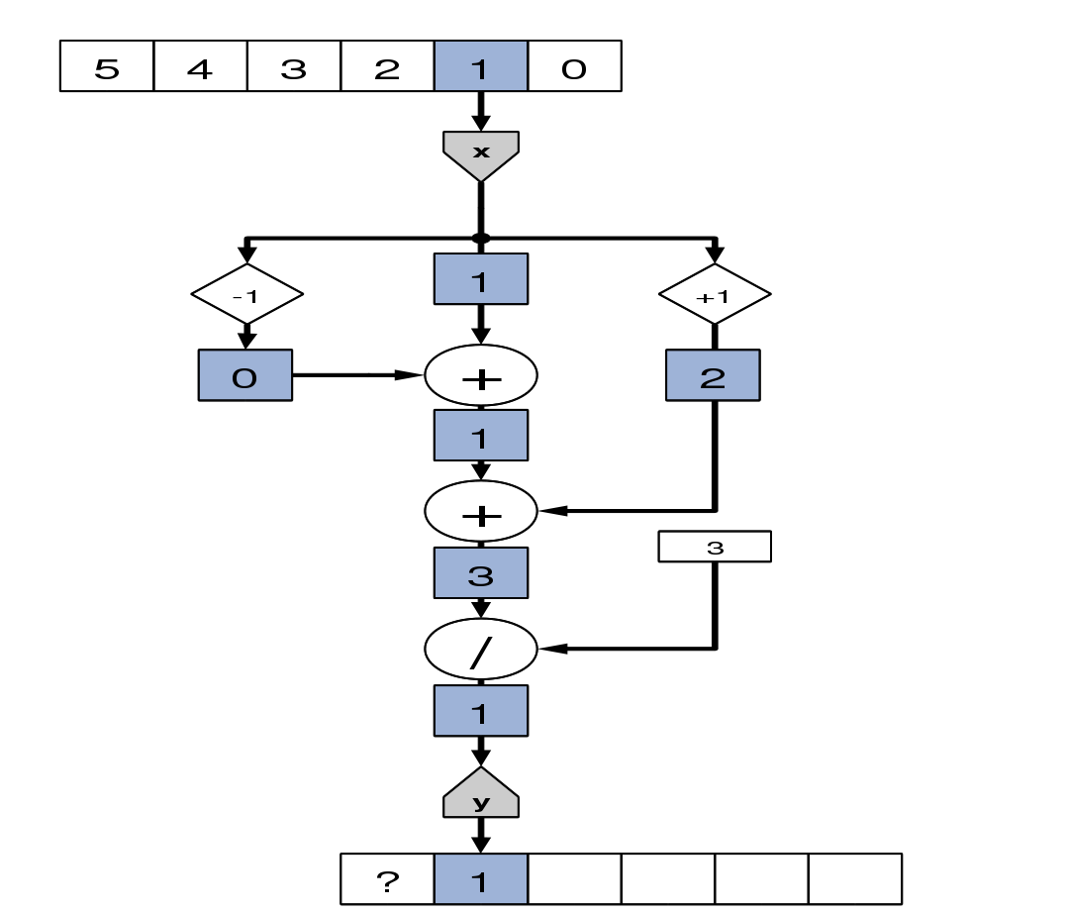
Kernel: What about Moving Average
63

Slide 64
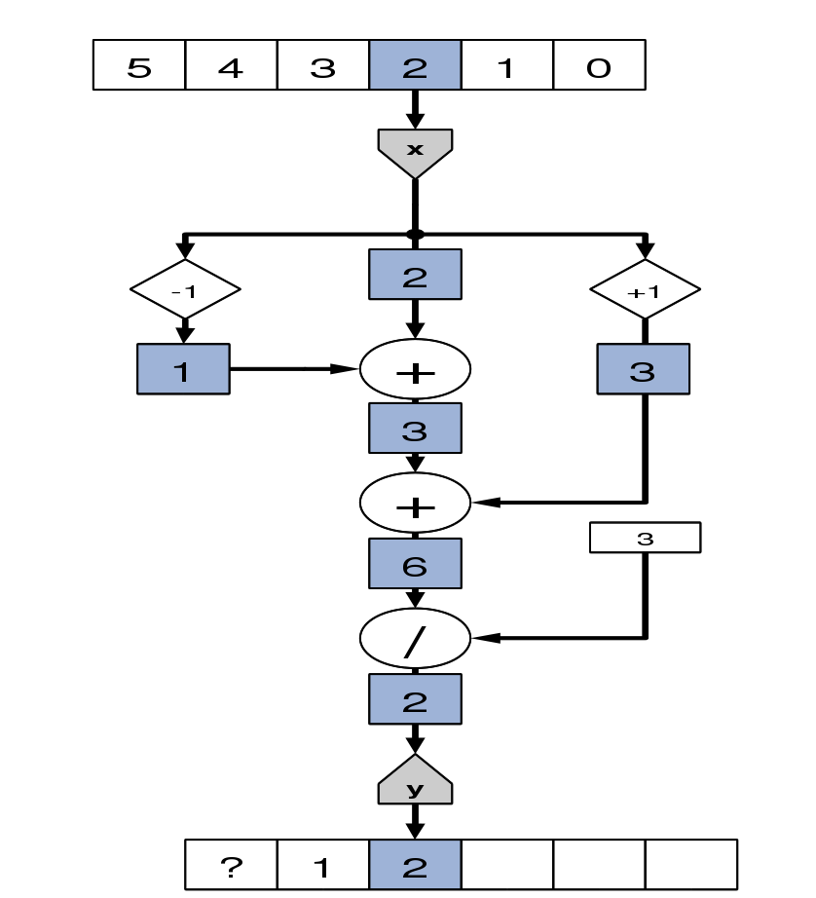
Kernel: What about Moving Average
64

Slide 65
Kernel: What about Moving Average
65

Slide 66
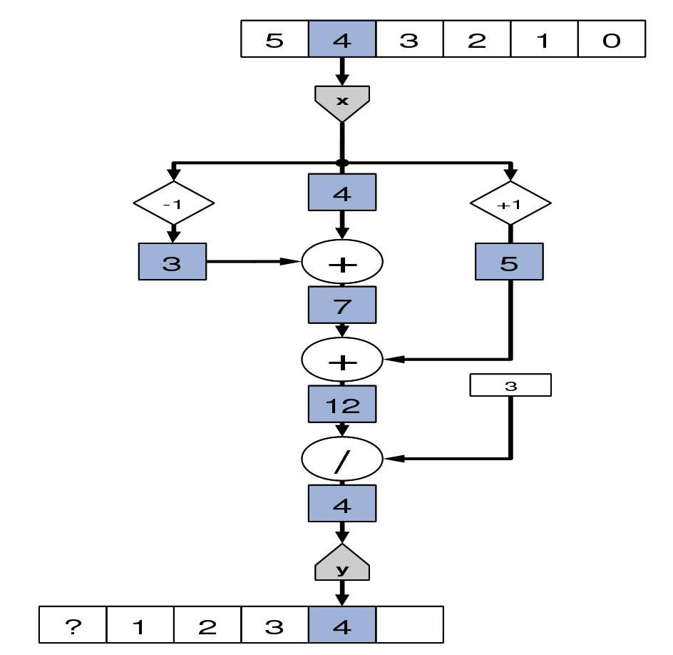
Kernel: What about Moving Average
66

Slide 67
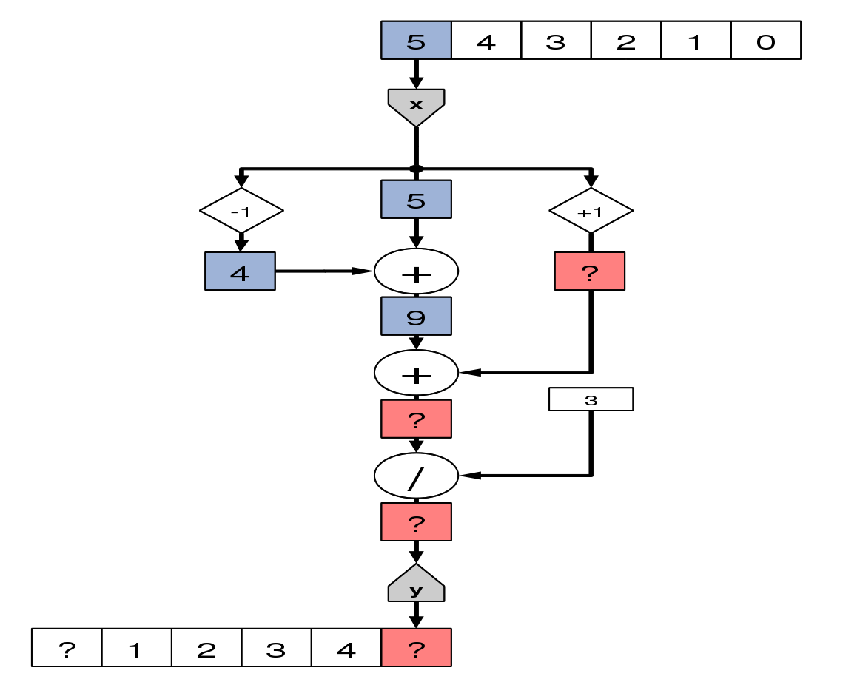
Kernel: What about Moving Average
What about the boundary cases?
67

Slide 68
MaxJ Intro: Conditionals
Data dependent conditional statements are extremely common
For example, How can we implement this in MaxJ?
int C = 500;
for (int i = 0; i < N; i++) {
if (x[i] > y[i])
result[i] = x[i] – y[i];
else
result[i] = C + x[i] + y[i];
}
68

Slide 69
MaxJ Intro: Conditionals
x
y
C
+
DFEVar x = io.input("x", type);
DFEVar y = io.input("y", type);
DFEVar C = io.scalarInput("C", type);
DFEVar result = x > y ?
(x - y) : (C + x + y);
OR:
DFEVar result = control.mux(x > y,
C + x + y, x – y);
The second option also allows for more than two inputs
-
+
>
false
true
Mux
Select
69

Slide 70
MaxJ Intro: Working with loop counters
How can we implement this in MaxCompiler?
for (int i = 0; i < N; i++) {
q[i] = p[i] + i;
}
How about this?
DFEVar p = io.input(“p”, dfeInt(32));
DFEVar i = io.input(“i”, dfeInt(32));
DFEVar q = p + i;
io.output(“q”, q, dfeInt(32));
d
i
+
q
Yes…. But, now we need to create an array i in software and send it to the DFE as well
70

Slide 71
MaxJ Intro: Working with loop counters
d
There is very little ‘information’ in the i stream.
Could compute it directly on the DFE itself
DFEVar p = io.input(“p”, dfeInt(32));
DFEVar i = control.count.simpleCounter(32, N);
DFEVar q = p + i;
io.output(“q”, q, dfeInt(32));
Counters can be used to generate sequences of numbers
Complex counters can have strides, wrap points, triggers:
E.g. if (y==10) y=0; else if (en==1) y=y+2;
cnt
+
Half as many inputs
Less data transfer
q
71

Slide 72
Kernel: What about Moving Average
What about the boundary cases?
72

Slide 73
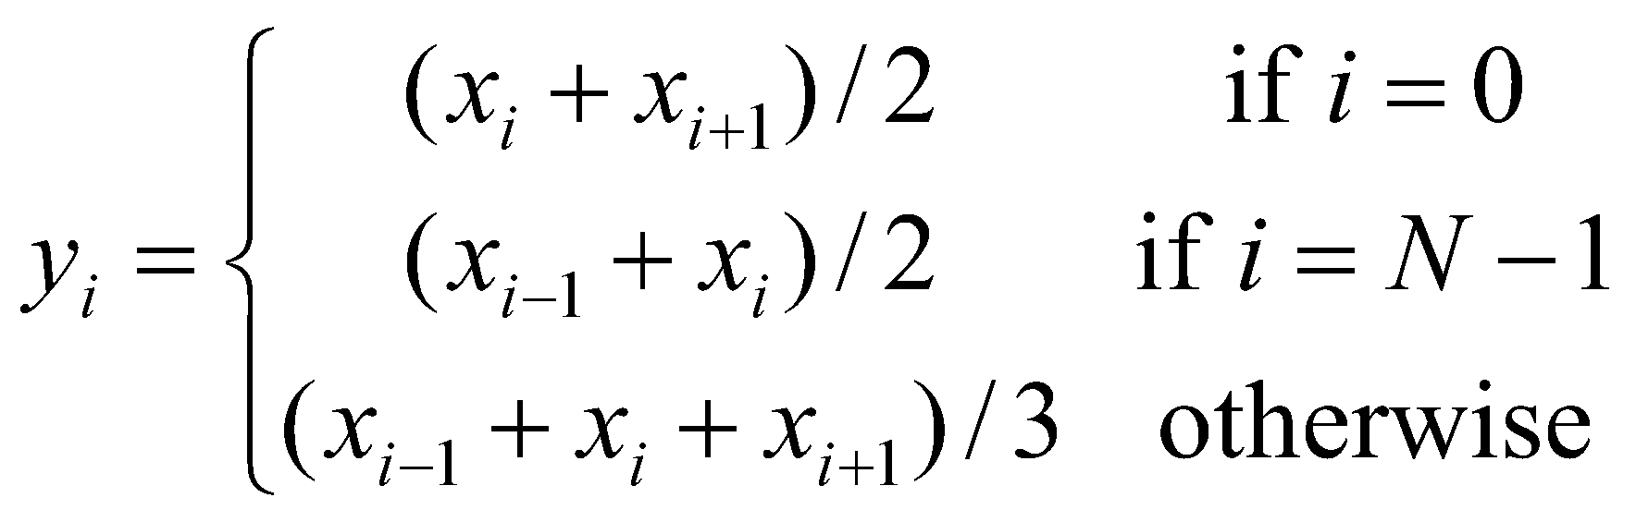
Kernel: Moving Average Boundaries
To handle the boundary cases, we must explicitly code special cases at each boundary
What about the boundary cases?
73

Slide 74
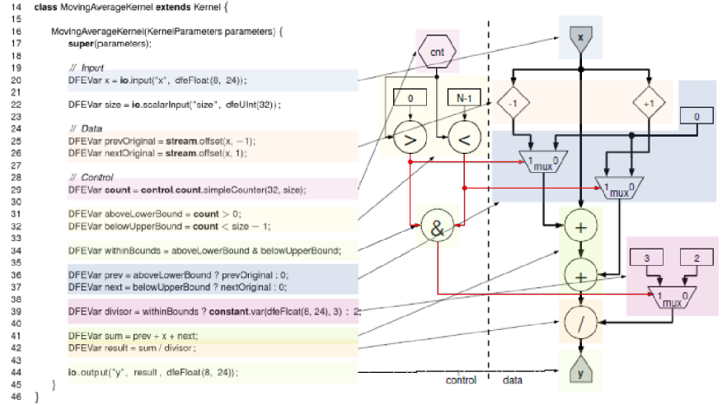
Kernel: What about Moving Average
74

Slide 75
Kernel: Scalar Inputs
Stream inputs/outputs process arrays
Read and write a new value each cycle
Off-chip data transfer required: O(N)
Counters can compute intermediate streams on-chip
New value every cycle
Off-chip data transfer required: None
Compile time constants can be combined with streams
Static value through the whole computation
Off-chip data transfer required: None
What about something that changes occasionally?
Don’t want to have to recompile → Scalar input
Off-chip data transfer required: O(1)
75

Slide 76
Kernel: Scalar Inputs
Consider
void fn1(int N, int *q, int *p) {
for (int i = 0; i < N; i++)
q[i] = p[i] + 4;
}
Vs
void fn2(int N, int *q, int *p, int C) {
for (int i = 0; i < N; i++)
q[i] = p[i] + C;
}
In fn2, we can change the value of C without recompiling, but it is constant for the whole loop
MaxCompiler equivalent:
DFEVar p = io.input(“p”, dfeInt(32));
DFEVar C = io.scalarInput(“C”, dfeInt(32));
DFEVar q = p + C;
io.output(“q”, q, dfeInt(32));
A scalar input can be changed once per stream, loaded into the chip before computation starts.
d
C
+
Written by host
q
76

Slide 77
Kernel: Scalar Input Use Cases
Things that do not change every cycle, but do change sometimes and we do not want to rebuild the .max file.
Constants in expressions
Flags to switch between two behaviours
result = enabled ? x + 7 : x;
Control parameters to counters, e.g. max, stride, etc
if (cnt==cnt_max) cnt=0; else cnt = cnt + cnt_step;
77

Slide 78
Kernel: On-chip Memories
The chip in a DFE has a few MB of very fast block RAM
Can be used to explicitly store data on chip:
Lookup tables
Temporary Buffers
Mapped ROMs/RAMs can also be accessed by host
d
Mapped ROM table
Written by host
q
for (i = 0; i < N; i++) {
q[i] = table[ p[i] ];
}
DFEVar p = io.input(“p”, dfeInt(10));
DFEVar q = mem.romMapped(“table”, p, dfeInt(32), 1024);
io.output(“q”, q, dfeInt(32));
78

Slide 79
Kernel: Getting Data In and Out
In general we have streams, ROMs (tables) and scalars
Use the most appropriate mechanism for the type of data and required host access speed.
Stream inputs/outputs can operate for a subset of cycles using a control signal to turn them on/off
Type | Size (items) | Host write speed | Chip area cost
Scalar input/output | 1 | Slow | Low
Mapped memory (ROM / RAM) | Up to a few thousand | Slow | Moderate
Stream input/output | Thousands to billions | Fast | Highest
79

Slide 80
Kernel: Stream Loop
A
uint A[...]; uint B[...];
for (int count=0; ; count += 1)
B[count] = A[count] + 1;
DFEVar A = io.input(”input” , dfeUInt(32));
DFEVar B = A + 1;
io.output(”output” , B , dfeUInt(32));
1
+
B
80

Slide 81
Kernel: Stream Loop with Counter
If the array subscripts are more complicated, you need to think about how to generate addresses for the DRAM
A
count
for (int count = 0; count < N ; count += 1)
B[count] = A[count] + count;
DFEVar A = io.input(”input” , dfeUInt(32));
DFEVar count = control.count.simpleCounter(32,N);
DFEVar B = A + count;
io.output(”output” , B , dfeUInt(32));
+
B
81

Slide 82
Kernel: Nested Loops
int count = 0;
for (int i=0; i<N; ++i) {
for (int j=0; j<M; ++j) {
B[count] = A[count]+(i*M)+j;
count += 1;
}
}
i
j
100
A
*
+
+
B
DFEVar A = io.input(”input” , dfeUInt(32));
CounterChain chain = control.count.makeCounterChain();
DFEVar j = chain.addCounter(M, 1).cast(dfeUInt(32));
DFEVar i = chain.addCounter(N, 1).cast(dfeUInt(32));
DFEVar B = A + i*100 + j;
io.output(”output” , B , dfeUInt(32));
82

Slide 83
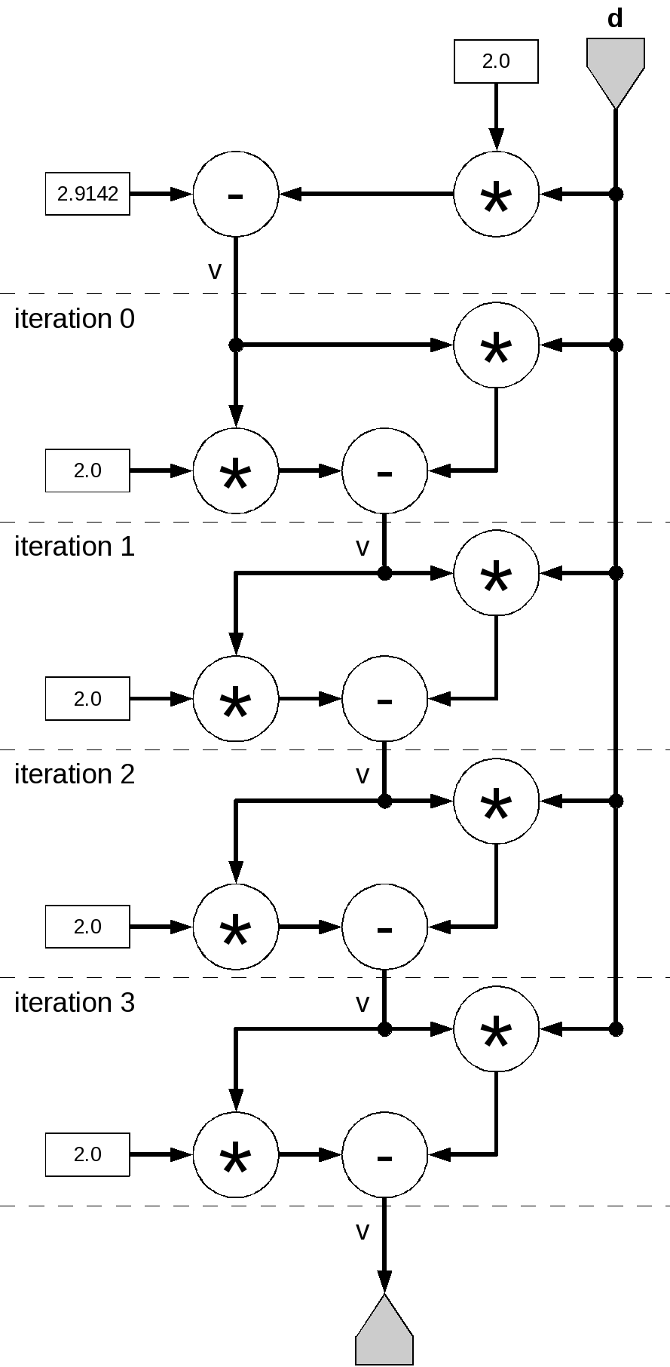
Kernel: Unrolling with Dependence
for (i = 0; ; i += 1) {
float d = input[i];
float v = 2.91 – 2.0*d;
for (iter=0; iter < 4; iter += 1)
v = v * (2.0 - d * v);
output[i] = v;
}
DFEVar d = io.input(”d”, dfeFix(24,12));
DFEVar TWO = constant.var(dfeFix(24,12), 2.0);
DFEVar v = constant.var(dfeFix(24,12), 2.91) − TWO*d;
for ( int iteration = 0; iteration < 4; iteration += 1) {
v = v*(TWO− d*v);
}
io.output(”output” , v, dfeFix(24,12));
The software loop has a cyclic dependency (v)
But the unrolled datapath is acyclic
83

Slide 84
Kernel: Variable Length Loop
for (count=0; ; count += 1) {
int d = input[count];
int shift = 0;
while (d != 0 && ((d & 0x3FF) != 0x291)) {
shift = shift + 1;
d = d >> 1;
}
output[count] = shift;
What do we do with a while loop (or a loop with a “break”)?
// converted to fixed length
for (count=0; ; count += 1) {
int d = input[count];
int shift = 0;
bool finished = false;
for (int i = 0; i < 22; ++i) {
bool condition = (d != 0 && ((d & 0x3FF) != 0x291));
finished = condition ? true : finished; // loop-carried
shift = finished ? shift : shift + 1; // dependencies
d = d >> 1;
}
output[count] = shift;
}
Count | Condition | Finished | Shift
1 | f | f | 1
2 | f | f | 2
3 | f | f | 3
4 | f | f | 4
5 | t | t | 5
6 | f | t | 5
7 | f | t | 5
8 | f | t | 5
9 | F | t | 5
Find maximum number of iterations
Execute all of them
Use bool to keep track of loop condition and keep result
84

Slide 85
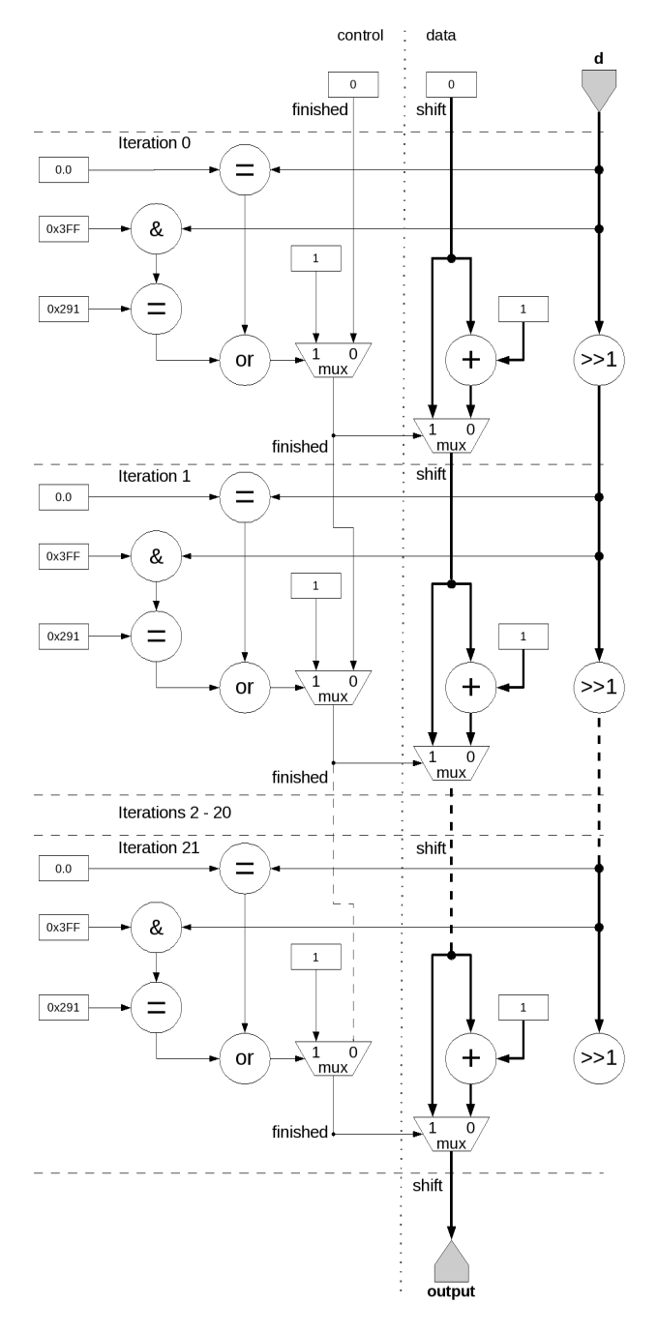
Kernel: Variable Length Loop in HW
for (count=0; ; count += 1) {
int d = input[count];
int shift = 0;
bool finished = false;
for (int i = 0; i < 22; ++i) {
bool condition=(d!=0&&((d&0x3FF)!=0x291));
finished = condition ? true : finished;
shift = finished ? shift : shift + 1;
d = d >> 1;
}
output[count] = shift;
}
DFEVar d = io.input(”d”, dfeUInt(32));
DFEVar shift = constant.var(dfeUInt(5), 0);
DFEVar finished = constant.var(dfeBool(), 0);
for ( int i = 0; i < 22; ++i) { // unrolled
DFEVar condition = d.neq(0)&((d&0x3FF).neq(0x291));
finished = condition ? constant.var(1) : finished ;
shift = finished ? shift : shift + constant.var(1);
d = d >> 1;
}
// Output
io.output(”output” , shift , dfeUInt(5));
85

Slide 86
Kernel: To Unroll or Not To Unroll
Loop Unrolling
Gets rid of loop-carried dependency by creating a long pipeline
Requires O(N) space on the chip...what if it does not fit?
If we can’t unroll, we end up with a cycle in the dataflow graph
We need to make sure the cycle in the graph is compatible with the pipeline depth
Variable-length loop (with loop-carried dependency)
Can be fully unrolled, BUT need to know maximal number of iterations
Utilization depends on actual data...
What if max iterations is much larger than average? Or max is not known? Or max iterations don’t fit on the chip?
86

Slide 87
Dataflow Programming Introduction:
CPU Integration
10.7.2019

Slide 88
CPU: Application Execution
1
2
MaxelerOS allocates a DFE
Application done!
I’m ready to run it...
Application
MaxelerOS
.max
file
CPU
PCIe, InfiniBand
DFE
3
DFE is configured using .max-file
4
DFE is Ready to use
DFE
DFE
88

Slide 89
CPU: Exportable DFE Configurations
C / Python / MATLAB / etc program
MaxCompiler
.max
file
.max file
collection
DFEs
CPU
CPU Memory
DFE Memory
Interconnect
89

Slide 90
CPU: .max File Contents
Either
DFE configuration data
DFE simulation model
DFE Interface Info
e.g. List of CPU settable values, number and names of I/O streams, etc.
CPU function code providing APIs specific to the .max file
90

Slide 91
CPU: SLiC Interface
Simple Live CPU Interface:
Combination of fixed software function calls and MaxCompiler-generated code for interacting with DFEs
By default all functions in all layers can be used from C
SLiC has a layered interface:
Basic Static – Single function-call to execute and complete a compute action on any appropriate DFE available
Advanced Static – Can be more specific about which DFE to use and enables use of multiple DFEs at once
Advanced Dynamic – Remove dependency on generated code from MaxCompiler in .max file for maximum flexibility
91

Slide 92
CPU: Skins
Enable SLiC calls across many languages:
Currently: C/C++, Python, MATLAB, R, Haskell
Upcoming: Java, Excel
Every .max-file usable from any supported language
.max file
SLiC-Compile
tool
MATLAB:
.mex + .m
C/C++:
.o
Haskell:
.o + .hi
Python:
.py + .so
R:
.tar.gz
92

Slide 93
CPU: Example
Simple example computation
z[i] = a × (y[i-1]+y[i]+y[i+1])+ x[i]
2 input streams, 1 input scalar, 1 output stream
x
y
-1
+1
public class ConvolveKernel extends Kernel {
static DFEType type = dfeFix(24,12);
public ConvolveKernel(KernelParameters parameters) {
super(parameters);
DFEVar x = io.input("x", type);
DFEVar y = io.input("y", type);
DFEVar a = io.scalarInput("a", type);
DFEVar conv = stream.offset(y,-1) + y
+ stream.offset(y,+1);
DFEVar z = a*conv + x;
io.output("z", z, type);
}
}
+
+
×
a
+
z
93

Slide 94
CPU: Example
#include “Convolve.h"
#include "MaxSLiCInterface.h"
int main(void)
{
const int size = 384;
int sizeBytes = size * sizeof(float);
float *x, *y, *z1, *z2;
int coeff1 = 3, coeff2 = 5;
printf("Generating data...\n");
// Allocate x,y,z of sizeBytes
// Initialize x, y data
printf("Convolving on DFE...\n");
Convolve(size, coeff1, x, y, z1);
Convolve(size, coeff2, x, z1, z2);
printf("Done.\n");
return 0;
}
public class ConvolveManager {
public static void main(String[] args) {
// Create kernel and manager
EngineParameters p = new EngineParameters(args);
Manager m = new Manager(p);
Kernel k = new ConvolveKernel(
m.makeKernelParameters());
// Set-up kernel I/O to/from CPU
m.setKernel(k);
m.setIO(
link("x", IODestination.CPU),
link("y", IODestination.CPU),
link("z", IODestination.CPU));
// Auto-generate simple SLiC interface
m.createSLiCinterface();
m.build();
}
}
SLiC function generated in MaxFile
void Convolve(int32_t param_N, double inscalar_ConvolveKernel_a,
const float* instream_x, const float* instream_y,
float* outstream_z);
94

Slide 95
Dataflow Programming Introduction:
HW Compilation
10.7.2019

Slide 96
Compilation: Graphs to DFE hardware
1
2
Design your kernels with MaxCompiler
Compile Using MaxCompiler
.maxj
Files
MaxCompiler
3
A Java Executable is Generated
4
.max
File
DFE Generator
Executable
HDL
Files
Running the Executable first
Generates HDL
6
Final output is generated
5
Chip
Vendor Tools
Then, it calls the
chip vendor tools
* Fully Automated
96

Slide 97
Compilation: Chip Vendor Back-End
Mon 16:27: MaxCompiler version: 2012.2
Mon 16:27: Build “MyKernel" start time: Mon Apr 08 16:27:24 BST 2013
Mon 16:27: Main build process running as user training1 on host Maxworkstation7478
Mon 16:27: Build location: /home/training1/maxcompiler-builds/MyKernel
Mon 16:27: Instantiating manager
Mon 16:27: Instantiating kernel “MyKernel"
Mon 16:27: Compiling manager (CPU I/O Only)
Mon 16:27: Compiling kernel "MyKernel"
Mon 16:27: Generating input files (VHDL, netlists, CoreGen)
Mon 16:27: Running back-end build (12 phases)
Mon 16:27: (1/12) - Prepare MaxFile Data (GenerateMaxFileDataFile)
Mon 16:27: (2/12) - Synthesize DFE Modules (XST)
Mon 16:30: (3/12) - Link DFE Modules (NGCBuild)
Mon 16:30: (4/12) - Prepare for Resource Analysis (EDIF2MxruBuildPass)
Mon 16:30: (5/12) - Generate Preliminary Annotated Source Code
Mon 16:30: (6/12) - Report Resource Usage (ResourceCounter)
Mon 16:30: About to start chip vendor Map/Place/Route toolflow. This will take some time.
Mon 16:30: (7/12) - Prepare for Placement (NGDBuild)
Mon 16:30: (8/12) - Place and Route DFE (MPPR)
Mon 16:30: Executing MPPR with 1 cost tables and 1 threads.
Mon 16:30: MPPR: Starting 1 cost table
Mon 16:43: MPPR: Cost table 1 met timing with score 0 (best score 0)
Mon 16:43: (9/12) - Prepare for Resource Analysis (XDLBuild)
Mon 16:44: (10/12) - Generate Resource Report (ResourceUsageBuildPass)
Mon 16:44: (11/12) - Generate Annotated Source Code (ResourceAnnotationBuildPass)
Mon 16:44: (12/12) - Generate MaxFile (GenerateMaxFile)
Mon 16:45: FINAL RESOURCE USAGE LUTs: 9503 / 149760 (6.35%) FFs: 12749 / 149760 (8.51%) BRAMs: 34 / 516 (6.59%)
chip vendor specific back-end tool flow
Abstracted by MaxCompiler
97

Slide 98
Compilation: On-Chip Resources
Different operations use different resources
Main resources
logic (LUTs)
state (Flip-flops)
27x18 bit multipliers (DSPs)
Block RAM (36Kb) + URAM(288Kb)
Wires and switches / Routing!
IO for off-chip communication
DSP Block (~6800)
I/O Block
Block RAM (~40 MByte)
LUT/FF (~1m)
98

Slide 99
Compilation: Resource Usage Report
Allows you to see which lines of code are using which resources and decide what to optimize
Separate reports for each kernel and for the manager
LUTs FFs BRAMs DSPs : MyKernel.java
727 871 1.0 2 : resources used by this file
0.24% 0.15% 0.09% 0.10% : % of available
71.41% 61.82% 100.00% 100.00% : % of total used
94.29% 97.21% 100.00% 100.00% : % of user resources
:
: public class MyKernel extends Kernel {
: public MyKernel (KernelParameters parameters) {
: super(parameters);
1 31 0.0 0 : DFEVar p = io.input("p", dfeFloat(8,24));
2 9 0.0 0 : DFEVar q = io.input("q", dfeUInt(8));
: DFEVar offset=io.scalarInput("ost", dfeUInt(8));
8 8 0.0 0 : DFEVar addr = offset + q;
18 40 1.0 0 : DFEVar v = mem.romMapped("table", addr,
: dfeFloat(8,24), 256);
139 145 0.0 2 : p = p * p;
401 541 0.0 0 : p = p + v;
: io.output("r", p, dfeFloat(8,24));
: }
: }
dfeFloat is
expensive
99

Slide 100
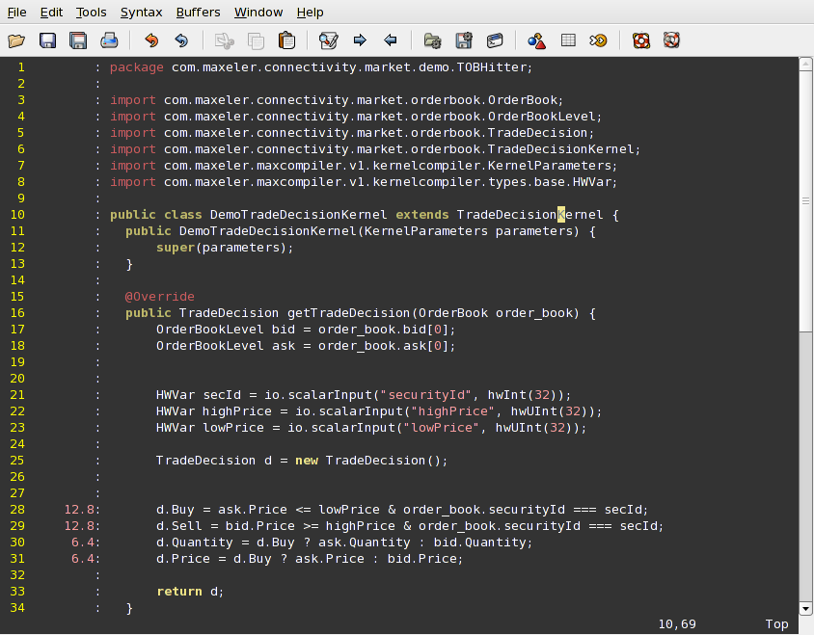
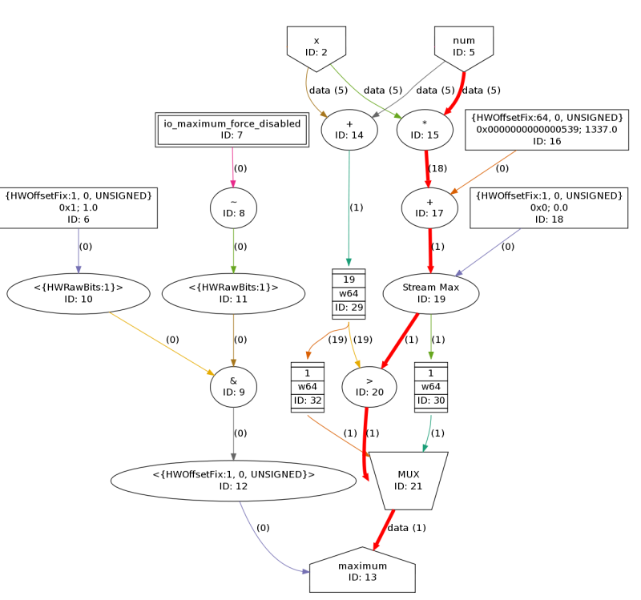
Compilation: Latency Report
MaxCompiler gives detailed latency and area annotation back to the programmer
Evaluate precise effect of code
on latency and chip area
+
=
12.8ns
6.4ns
19.2ns (total compute latency)
100

Slide 101
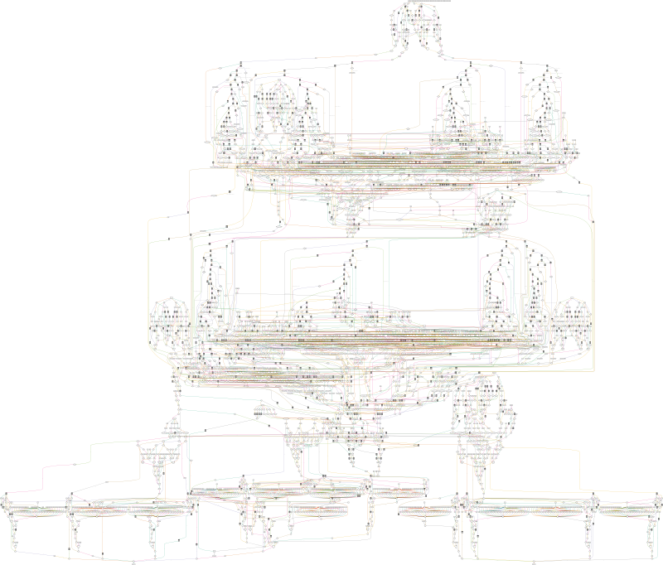
Compilation: Dataflow Graph
Real data flow graph as generated by MaxCompiler
4866 nodes
10,000s of stages/cycles
101

Slide 102
Hands on Example
10.7.2019

Slide 103
Login
Three shared accounts to have a first look around
https://webide.maxeler.com
Full development environment on AWS:
MaxCompiler AMI on AWS marketplace
https://aws.amazon.com/marketplace/pp/Maxeler-Technologies-Inc-MaxCompiler-AMI/B07K6TGWNQ
For further information contact either info@maxeler.com or nvoss@maxeler.com
User | Password
user32 | 1275
user33 | 1158
user34 | 1342
103

